Slide 1
Chapter 02 Syntax Directed Translation
simple example
by Lin Yi
ly_cs@nwpu.edu.cn

Slide 2
BNF Notation & Grammar Definition BNF表示 & 文法定义
【R1】 stmt->do stmt while ( expr ) ;
【R2】 stmt->expr;
【R3】 expr->rel = expr
【R4】 | rel
【R5】 rel->rel < add
【R6】 | rel <= add
【R7】 | add
【R8】 add->add + term
【R9 】 | term
【R10】term->term * factor
【R11】 | factor
【R12】factor->( expr )
【R13】 | num
【R14】 | id
【R15】 | id [ id ]
文法G[stmt] / Grammar G[stmt]
（1）开始符 / start symbol
stmt （开始符是唯一的 / only one start symbol）
（2）非终结符 / Non-terminal symbol
所有可以被替换为规则右侧其他符号的符号。
All symbols that could be replaced with the right part of a rule.
例如 / e.g： stmt，expr， rel
（3）终结符 / terminal symbol
所有不能再被替换的符号（词法符号）。
All symbols that couldn’t be replaced anymore (lexical symbols or lexemes).
（4）文法规则 / Grammar Rules
例如 / e.g：【R1】stmt -> do stmt while ( expr ) ;
其他表示方法 / other representation：
stmt ::= ‘do’ stmt ‘while’ ‘(‘ expr ‘)’ ‘;’ // ‘do’，’while’ are strings
（5）规则的简化表示/brief representation for rules
G[A] with 2 rules：【R1】 A -> X 【R2】 A -> Y
简化形式/ brief form：A -> X | Y （仍然是两条规则 / here are two rules )
或 / or：
A -> X
| Y

Slide 3
BNF Notation & Grammar Definition BNF表示 & 文法定义（无动画）
【R1】 stmt->do stmt while ( expr ) ;
【R2】 stmt->expr;
【R3】 expr->rel = expr
【R4】 | rel
【R5】 rel->rel < add
【R6】 | rel <= add
【R7】 | add
【R8】 add->add + term
【R9 】 | term
【R10】term->term * factor
【R11】 | factor
【R12】factor->( expr )
【R13】 | num
【R14】 | id
【R15】 | id [ id ]
文法G[stmt] / Grammar G[stmt]
（1）开始符 / start symbol
stmt （开始符是唯一的 / only one start symbol）
（2）非终结符 / Non-terminal symbol
所有可以被替换为规则右侧其他符号的符号。
All symbols that could be replaced with the right part of a rule.
例如 / e.g： stmt，expr， rel
（3）终结符 / terminal symbol
所有不能再被替换的符号（词法符号）。
All symbols that couldn’t be replaced anymore (lexical symbols or lexemes).
（4）文法规则 / Grammar Rules
例如 / e.g：【R1】stmt -> do stmt while ( expr ) ;
其他表示方法 / other representation：
stmt ::= ‘do’ stmt ‘while’ ‘(‘ expr ‘)’ ‘;’ // ‘do’，’while’ are strings
（5）规则的简化表示/brief representation for rules
G[A] with 2 rules：【R1】 A -> X 【R2】 A -> Y
简化形式/ brief form：A -> X | Y （仍然是两条规则 / here are two rules )
或 / or：
A -> X
| Y

Slide 4
BNF Notation & Grammar Definition BNF表示 & 文法定义（完整动画）
【R1】 stmt->do stmt while ( expr ) ;
【R2】 stmt->expr;
【R3】 expr->rel = expr
【R4】 | rel
【R5】 rel->rel < add
【R6】 | rel <= add
【R7】 | add
【R8】 add->add + term
【R9 】 | term
【R10】term->term * factor
【R11】 | factor
【R12】factor->( expr )
【R13】 | num
【R14】 | id
【R15】 | id [ id ]
文法G[stmt] / Grammar G[stmt]
（1）开始符 / start symbol
stmt （开始符是唯一的 / only one start symbol）
（2）非终结符 / Non-terminal symbol
所有可以被替换为规则右侧其他符号的符号。
All symbols that could be replaced with the right part of a rule.
例如 / e.g： stmt，expr， rel
（3）终结符 / terminal symbol
所有不能再被替换的符号（词法符号）。
All symbols that couldn’t be replaced anymore (lexical symbols or lexemes).
（4）文法规则 / Grammar Rules
例如 / e.g：【R1】stmt -> do stmt while ( expr ) ;
其他表示方法 / other representation：
stmt ::= ‘do’ stmt ‘while’ ‘(‘ expr ‘)’ ‘;’ // ‘do’，’while’ are strings
（5）规则的简化表示/brief representation for rules
G[A] with 2 rules：【R1】 A -> X 【R2】 A -> Y
简化形式/ brief form：A -> X | Y （仍然是两条规则 / here are two rules )
或 / or：
A -> X
| Y

Slide 5
推导（运用BNF规则）：本节仅使用最左推导 Derivation with BNF rules ----only use left-most derivation in this chapter
文法G[stmt] / Grammar G[stmt]
（6）最左推导 / left-most derivation
注意 / Notice：推导技术其他内容在下一章介绍
/ Next chapter will introduce details about derivation concept.
例如 / e.g. （最左非终结符替换 / replace the left-most non-terminal symbol）
【example 1】stmt => do stmt while ( expr ) ;
【example 2】rel => rel < add
【example 3：从开始符出发的推导链 / chain of derivation from start symbol】
stmt => do stmt while ( expr ) ;
=> do expr ; while ( expr ) ;
【example 4】do-while嵌套 / do-while inside do-while
stmt => do stmt while ( expr ) ;
=> do do stmt while (expr ) ; while ( expr ) ;
【R1】 stmt->do stmt while ( expr ) ;
【R2】 stmt->expr;
【R3】 expr->rel = expr
【R4】 | rel
【R5】 rel->rel < add
【R6】 | rel <= add
【R7】 | add
【R8】 add->add + term
【R9 】 | term
【R10】term->term * factor
【R11】 | factor
【R12】factor->( expr )
【R13】 | num
【R14】 | id
【R15】 | id [ id ]

Slide 6
推导（运用BNF规则）：本节仅使用最左推导 Derivation with BNF rules（无动画） ----only use left-most derivation in this chapter
文法G[stmt] / Grammar G[stmt]
（6）最左推导 / left-most derivation
注意 / Notice：推导技术其他内容在下一章介绍
/ Next chapter will introduce details about derivation concept.
例如 / e.g. （最左非终结符替换 / replace the left-most non-terminal symbol）
【example 1】stmt => do stmt while ( expr ) ;
【example 2】rel => rel < add
【example 3：从开始符出发的推导链 / chain of derivation from start symbol】
stmt => do stmt while ( expr ) ;
=> do expr ; while ( expr ) ;
【example 4】do-while嵌套 / do-while inside do-while
stmt => do stmt while ( expr ) ;
=> do do stmt while (expr ) ; while ( expr ) ;
【R1】 stmt->do stmt while ( expr ) ;
【R2】 stmt->expr;
【R3】 expr->rel = expr
【R4】 | rel
【R5】 rel->rel < add
【R6】 | rel <= add
【R7】 | add
【R8】 add->add + term
【R9 】 | term
【R10】term->term * factor
【R11】 | factor
【R12】factor->( expr )
【R13】 | num
【R14】 | id
【R15】 | id [ id ]

Slide 7
推导（运用BNF规则）：本节仅使用最左推导 Derivation with BNF rules（完整动画） ----only use left-most derivation in this chapter
文法G[stmt] / Grammar G[stmt]
（6）最左推导 / left-most derivation
注意 / Notice：推导技术其他内容在下一章介绍
/ Next chapter will introduce details about derivation concept.
例如 / e.g. （最左非终结符替换 / replace the left-most non-terminal symbol）
【example 1】stmt => do stmt while ( expr ) ;
【example 2】rel => rel < add
【example 3：从开始符出发的推导链 / chain of derivation from start symbol】
stmt => do stmt while ( expr ) ;
=> do expr ; while ( expr ) ;
【example 4】do-while嵌套 / do-while inside do-while
stmt => do stmt while ( expr ) ;
=> do do stmt while (expr ) ; while ( expr ) ;
【R1】 stmt->do stmt while ( expr ) ;
【R2】 stmt->expr;
【R3】 expr->rel = expr
【R4】 | rel
【R5】 rel->rel < add
【R6】 | rel <= add
【R7】 | add
【R8】 add->add + term
【R9 】 | term
【R10】term->term * factor
【R11】 | factor
【R12】factor->( expr )
【R13】 | num
【R14】 | id
【R15】 | id [ id ]

Slide 8
Grammar & derivation 文法定义和推导
（1）stmt=>do stmt while (expr)
（2） =>do expr ; while (expr)
（3） =>do rel = expr ; while (expr)
（4） =>do add = expr ; while (expr)
（5） =>do term = expr ; while (expr)
（6） =>do factor = expr ; while (expr)
（7） =>do id<i> = expr ; while (expr)
（8） =>do i = rel ; while (expr)
（9） =>do i = add ; while (expr)
（10） =>do i = add + term ; while (expr)
（11） =>do i = term + term ; while (expr)
（12） =>do i = factor + term ; while (expr)
【R1】 stmt->do stmt while ( expr ) ;
【R2】 stmt->expr;
【R3】 expr->rel = expr
【R4】 | rel
【R5】 rel->rel < add
【R6】 | rel <= add
【R7】 | add
【R8】 add->add + term
【R9 】 | term
【R10】term->term * factor
【R11】 | factor
【R12】factor->( expr )
【R13】 | num
【R14】 | id
【R15】 | id [ id ]
do id=expr; while(expr)
//注：id<i>应该是id，
//写为id<i>是为了方便
//看出这个标识符是’i’
R4：
expr->rel
do id = rel ; while (expr)
//简便起见，id=rel写为i=rel

Slide 9
Grammar & derivation 文法定义和推导
（1）stmt=>do stmt while (expr)
（12） =>do i = factor + term ; while (expr)
（13） =>do i = id<i> + term ; while (expr)
（14） =>do i = i + factor ; while (expr)
（15） =>do i = i + num<1> ; while (expr)
（16） =>do i = i + 1 ; while (rel)
（17） =>do i = i + 1 ; while (rel < add )
（18） =>do i = i + 1 ; while (add < add)
（19） =>do i = i + 1 ; while (term < add)
（20） =>do i = i + 1 ; while (factor < add)
（21） =>do i = i + 1 ; while (id<a>[id<i>] < add)
（22） =>do i = i + 1 ; while (a[i] < term)
（23） =>do i = i + 1 ; while (a[i] < factor)
（24） =>do i = i + 1 ; while (a[i] < id<v>)
（25） =>do i = i + 1 ; while (a[i] < v)
【R1】 stmt->do stmt while ( expr ) ;
【R2】 stmt->expr;
【R3】 expr->rel = expr
【R4】 | rel
【R5】 rel->rel < add
【R6】 | rel <= add
【R7】 | add
【R8】 add->add + term
【R9 】 | term
【R10】term->term * factor
【R11】 | factor
【R12】factor->( expr )
【R13】 | num
【R14】 | id
【R15】 | id [ id ]
G[stmt]可能存在一些文法bug：
(1)a*b=c在文法上是正确的；
(2)a[i]合法，但a[3]非法;
(3)a=b=c是否支持？
(4)a<b<c是否支持？
(5)a<(b<c)是否支持？

Slide 10
Grammar & derivation（无动画） 文法定义和推导
（1）stmt=>do stmt while (expr)
（2） =>do expr ; while (expr)
（3） =>do rel = expr ; while (expr)
（4） =>do add = expr ; while (expr)
（5） =>do term = expr ; while (expr)
（6） =>do factor = expr ; while (expr)
（7） =>do id<i> = expr ; while (expr)
（8） =>do i = rel ; while (expr)
（9） =>do i = add ; while (expr)
（10） =>do i = add + term ; while (expr)
（11） =>do i = term + term ; while (expr)
（12） =>do i = factor + term ; while (expr)
【R1】 stmt->do stmt while ( expr ) ;
【R2】 stmt->expr;
【R3】 expr->rel = expr
【R4】 | rel
【R5】 rel->rel < add
【R6】 | rel <= add
【R7】 | add
【R8】 add->add + term
【R9 】 | term
【R10】term->term * factor
【R11】 | factor
【R12】factor->( expr )
【R13】 | num
【R14】 | id
【R15】 | id [ id ]

Slide 11
Grammar & derivation（无动画） 文法定义和推导
（1）stmt=>do stmt while (expr)
（12） =>do i = factor + term ; while (expr)
（13） =>do i = id<i> + term ; while (expr)
（14） =>do i = i + factor ; while (expr)
（15） =>do i = i + num<1> ; while (expr)
（16） =>do i = i + 1 ; while (rel)
（17） =>do i = i + 1 ; while (rel < add )
（18） =>do i = i + 1 ; while (add < add)
（19） =>do i = i + 1 ; while (term < add)
（20） =>do i = i + 1 ; while (factor < add)
（21） =>do i = i + 1 ; while (id<a>[id<i>] < add)
（22） =>do i = i + 1 ; while (a[i] < term)
（23） =>do i = i + 1 ; while (a[i] < factor)
（24） =>do i = i + 1 ; while (a[i] < id<v>)
（25） =>do i = i + 1 ; while (a[i] < v)
【R1】 stmt->do stmt while ( expr ) ;
【R2】 stmt->expr;
【R3】 expr->rel = expr
【R4】 | rel
【R5】 rel->rel < add
【R6】 | rel <= add
【R7】 | add
【R8】 add->add + term
【R9 】 | term
【R10】term->term * factor
【R11】 | factor
【R12】factor->( expr )
【R13】 | num
【R14】 | id
【R15】 | id [ id ]

Slide 12
Parsing Tree & left-most derivation 分析树与最左推导
【R1】 stmt->do stmt while ( expr ) ;
【R2】 stmt->expr;
【R3】 expr->rel = expr
【R4】 | rel
【R5】 rel->rel < add
【R6】 | rel <= add
【R7】 | add
【R8】 add->add + term
【R9 】 | term
【R10】term->term * factor
【R11】 | factor
【R12】factor->( expr )
【R13】 | num
【R14】 | id
【R15】 | id [ id ]
（1）stmt=>do stmt while (expr)
（2） =>do expr ; while (expr)
（3） =>do rel = expr ; while (expr)
（4） =>do add = expr ; while (expr)
（5） =>do term = expr ; while (expr)
（6） =>do factor = expr ; while (expr)
（7） =>do id<i> = expr ; while (expr)
（8） =>do i = rel ; while (expr)
（9） =>do i = add ; while (expr)
（10） =>do i = add + term ; while (expr)
（11） =>do i = term + term ; while (expr)
（12） =>do i = factor + term ; while (expr)
（1）【R1】 stmt->do stmt while ( expr ) ;
stmt
do
stmt
while
(
expr
)
（2）【R2】stmt->expr ;
expr
;
rel
=
expr
（3）
（1）Parsing Tree / 分析树，又称作Concrete Syntax Tree / 具体语法树。
（2）分析树包含很多语法定义中的具体符号，如stmt、expr等在源程序中不会出现的非终结符。因为这些符号与具体的语法定义有关，所以也叫具体语法树。
Parsing tree contains many abstract symbols defined in concrete grammar description, such as stmt, expr, which don’t existed in program source code. Since these symbols are related to concrete grammar design, it’s also name as concrete syntax tree.

Slide 13
Parsing Tree/分析树（具体语法树）
stmt=>do stmt while (expr)
=>do expr; while (expr)
=>do rel = expr ; while (expr)
=>do add = expr ; while (expr)
=>do term = expr ; while (expr)
=>do factor = expr ; while (expr)
=>do id<i> = expr ; while (expr)
=>do i = rel ; while (expr)
=>do i = add ; while (expr)
=>do i = add + term ; while (expr)
=>do i = term + term ; while (expr)
=>do i = factor + term ; while (expr)
=>do i = id<i> + term ; while (expr)
=>do i = i + factor ; while (expr)
=>do i = i + num<1> ; while (expr)
=>do i = i + 1 ; while (rel)
=>do i = i + 1 ; while (rel < add )
=>do i = i + 1 ; while (add < add)
=>do i = i + 1 ; while (term < add)
=>do i = i + 1 ; while (factor < add)
=>do i = i + 1 ; while (id<a>[id<i>] < add)
=>do i = i + 1 ; while (a[i] < term)
=>do i = i + 1 ; while (a[i] < factor)
=>do i = i + 1 ; while (a[i]] < id<v>)
=>do i = i + 1 ; while (a[i]] < v)
stmt
do
stmt
while
(
expr
)
expr
;
rel
rel
=
expr
rel
<
add
add
rel
add
term
factor
term
add
term
id
factor
add
+
term
factor
v
id
term
factor
id
[
id
]
i
factor
num
a
i
id
1
i

Slide 14
Parsing Tree/分析树（具体语法树）/动画演示
当前语法树的叶子节点，从左到右看，正好是当前推导得到的符号序列
/ All leaf nodes of current parsing tree, are exactly the string of symbols of current left-most derivation step.
stmt=>do stmt while (expr)
=>do expr; while (expr)
stmt
=>do rel = expr ; while (expr)
=>do add = expr ; while (expr)
=>do term = expr ; while (expr)
=>do factor = expr ; while (expr)
=>do id<i> = expr ; while (expr)
=>do i = rel ; while (expr)
=>do i = add ; while (expr)
=>do i = add + term ; while (expr)
=>do i = term + term ; while (expr)
=>do i = factor + term ; while (expr)
=>do i = id<i> + term ; while (expr)
=>do i = i + factor ; while (expr)
=>do i = i + num<1> ; while (expr)
=>do i = i + 1 ; while (rel)
=>do i = i + 1 ; while (rel < add )
=>do i = i + 1 ; while (add < add)
=>do i = i + 1 ; while (term < add)
=>do i = i + 1 ; while (factor < add)
=>do i = i + 1 ; while (id<a>[id<i>] < add)
=>do i = i + 1 ; while (a[i] < term)
=>do i = i + 1 ; while (a[i] < factor)
=>do i = i + 1 ; while (a[i]] < id<v>)
=>do i = i + 1 ; while (a[i]] < v)
do
stmt
while
(
expr
)
while
expr
;
rel
rel
=
expr
rel
<
add
add
rel
add
term
factor
term
add
term
id
factor
add
+
term
factor
v
id
term
id
[
id
]
i
factor
num
a
i
id
1
i

Slide 15
Parsing Tree/分析树（具体语法树）/动画演示
stmt=>do stmt while (expr)
=>do expr; while (expr)
=>do rel = expr ; while (expr)
=>do add = expr ; while (expr)
=>do term = expr ; while (expr)
=>do factor = expr ; while (expr)
=>do id<i> = expr ; while (expr)
=>do i = rel ; while (expr)
=>do i = add ; while (expr)
=>do i = add + term ; while (expr)
当前语法树的叶子节点，从左到右看，正好是当前推导得到的符号序列
/ All leaf nodes of current parsing tree, are exactly the string of symbols of current left-most derivation step.
stmt
do
stmt
while
(
expr
)
expr
;
rel
rel
=
expr
rel
<
add
=>do i = term + term ; while (expr)
=>do i = factor + term ; while (expr)
=>do i = id<i> + term ; while (expr)
=>do i = i + factor ; while (expr)
=>do i = i + num<1> ; while (expr)
=>do i = i + 1 ; while (rel)
=>do i = i + 1 ; while (rel < add )
=>do i = i + 1 ; while (add < add)
=>do i = i + 1 ; while (term < add)
=>do i = i + 1 ; while (factor < add)
=>do i = i + 1 ; while (id<a>[id<i>] < add)
=>do i = i + 1 ; while (a[i] < term)
=>do i = i + 1 ; while (a[i] < factor)
=>do i = i + 1 ; while (a[i]] < id<v>)
=>do i = i + 1 ; while (a[i]] < v)
term
add
rel
add
factor
term
add
term
id
factor
add
+
term
factor
v
id
term
factor
id
[
id
]
i
factor
num
a
i
id
1
i

Slide 16
Parsing Tree/分析树（具体语法树）/无动画
stmt=>do stmt while (expr)
=>do expr; while (expr)
=>do rel = expr ; while (expr)
=>do add = expr ; while (expr)
=>do term = expr ; while (expr)
=>do factor = expr ; while (expr)
=>do id<i> = expr ; while (expr)
=>do i = rel ; while (expr)
=>do i = add ; while (expr)
=>do i = add + term ; while (expr)
=>do i = term + term ; while (expr)
=>do i = factor + term ; while (expr)
=>do i = id<i> + term ; while (expr)
=>do i = i + factor ; while (expr)
=>do i = i + num<1> ; while (expr)
=>do i = i + 1 ; while (rel)
=>do i = i + 1 ; while (rel < add )
=>do i = i + 1 ; while (add < add)
=>do i = i + 1 ; while (term < add)
=>do i = i + 1 ; while (factor < add)
=>do i = i + 1 ; while (id<a>[id<i>] < add)
=>do i = i + 1 ; while (a[i] < term)
=>do i = i + 1 ; while (a[i] < factor)
=>do i = i + 1 ; while (a[i]] < id<v>)
=>do i = i + 1 ; while (a[i]] < v)
stmt
do
stmt
while
(
expr
)
expr
;
rel
rel
=
expr
rel
<
add
add
rel
add
term
factor
term
add
term
id
factor
add
+
term
factor
v
id
term
factor
id
[
id
]
i
factor
num
a
i
id
1
i

Slide 17
Parsing Tree/分析树（具体语法树）/完整动画
stmt=>do stmt while (expr)
=>do expr; while (expr)
=>do rel = expr ; while (expr)
=>do add = expr ; while (expr)
=>do term = expr ; while (expr)
=>do factor = expr ; while (expr)
=>do id<i> = expr ; while (expr)
=>do i = rel ; while (expr)
=>do i = add ; while (expr)
=>do i = add + term ; while (expr)
=>do i = term + term ; while (expr)
=>do i = factor + term ; while (expr)
=>do i = id<i> + term ; while (expr)
=>do i = i + factor ; while (expr)
=>do i = i + num<1> ; while (expr)
=>do i = i + 1 ; while (rel)
=>do i = i + 1 ; while (rel < add )
=>do i = i + 1 ; while (add < add)
=>do i = i + 1 ; while (term < add)
=>do i = i + 1 ; while (factor < add)
=>do i = i + 1 ; while (id<a>[id<i>] < add)
=>do i = i + 1 ; while (a[i] < term)
=>do i = i + 1 ; while (a[i] < factor)
=>do i = i + 1 ; while (a[i]] < id<v>)
=>do i = i + 1 ; while (a[i]] < v)
stmt
do
stmt
while
(
expr
)
expr
;
rel
rel
=
expr
rel
<
add
add
rel
add
term
factor
term
add
term
id
factor
add
+
term
factor
v
id
term
factor
id
[
id
]
i
factor
num
a
i
id
1
i

Slide 18
2022/03/15，星期二/Tuesday

Slide 19
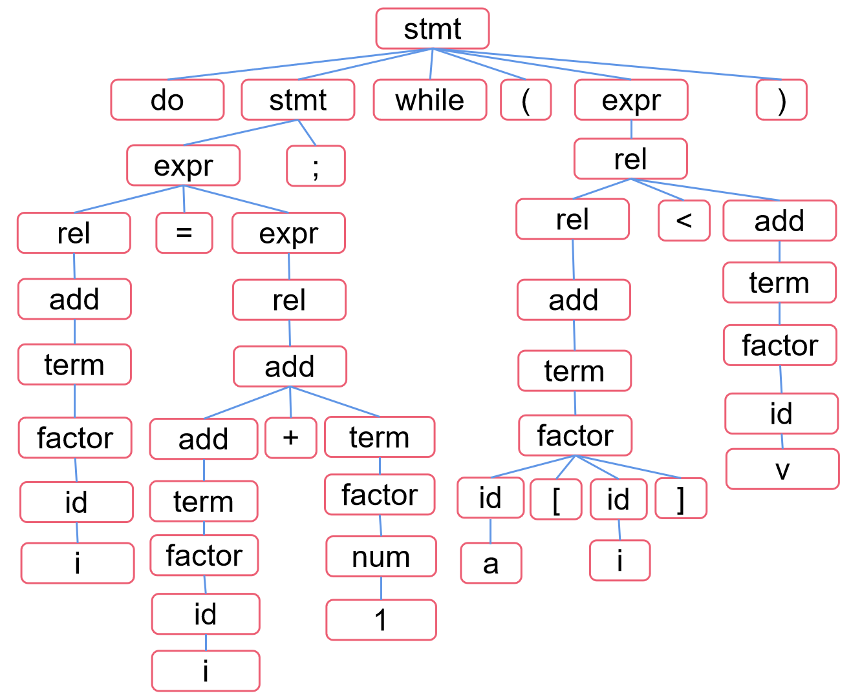
分析树=>抽象语法树 Parsing Tree=>Abstract Syntax Tree (AST)
do i = i + 1; while ( a[i] < v );
分析器/Parser
【R1】 stmt->do stmt while ( expr ) ;
【R2】 stmt->expr;
【R3】 expr->rel = expr
【R4】 | rel
【R5】 rel->rel < add
【R6】 | rel <= add
【R7】 | add
【R8】 add->add + term
【R9 】 | term
【R10】term->term * factor
【R11】 | factor
【R12】factor->( expr )
【R13】 | num
【R14】 | id
【R15】 | id [ id ]
抽象语法树(AST)
/Abstract Syntax Tree (AST)
语法规则
/ Grammar Rules
具体语法树(分析树)
/Concrete Syntax Tree ( Parsing Tree)

Slide 20
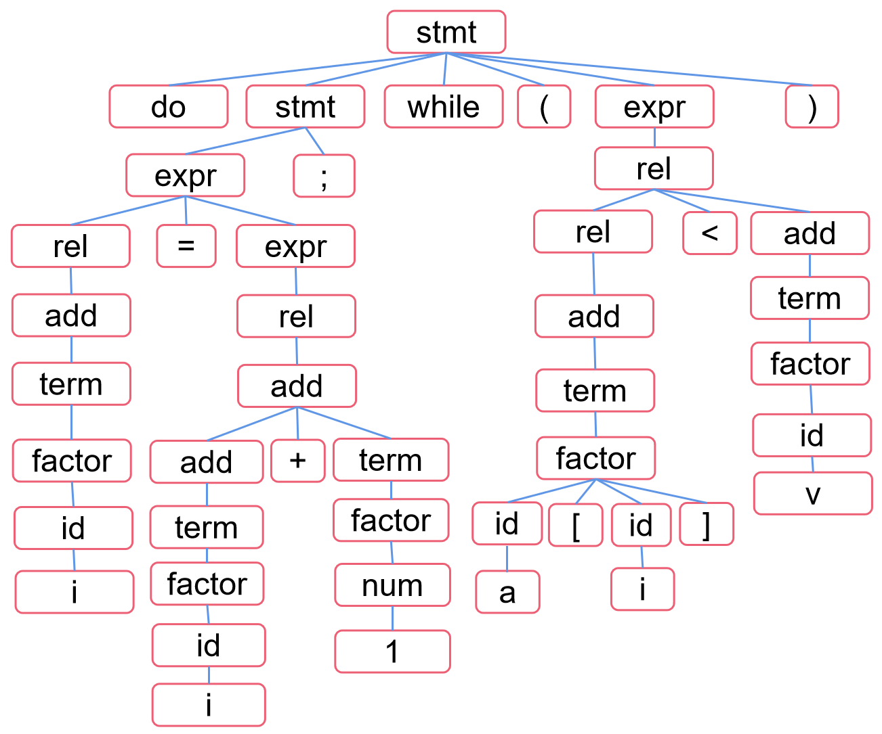
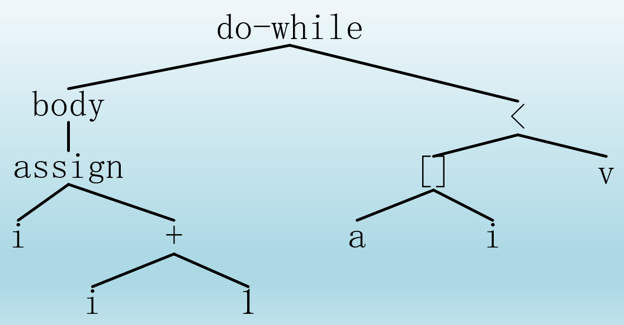
分析树=>AST Parsing Tree=>AST
 | 文法规则 / Grammar Rules |  |  | 语义动作 / Semantic Action
1 | program | → | block | { return block.n;}
2 | block | → | ‘{‘stmts ‘}’ | {block.n=stmts.n;}
3 | stmts | → | stmts1 | {stmts.n=new Seq(stmts1.n,stmt.n);}
4 |  |  | | ε | { stmts.n=null;}
5 | stmt | → | expr ‘;’ | {stmt.n=new Eval(expr.n);}
6 |  |  | | ‘if’‘(‘expr ‘)’stmt1 | {stmt.n=new If(expr.n, stmt1.n);}
7 |  |  | | ‘while' ‘(‘expr ‘)’stmt1 | {stmt.n=new While(expr.n, stmt1.n);}
8 |  |  | | ‘do’stmt1 ‘while’‘(‘expr ‘)’’;’ | {stmt.n=new Do(stmt1.n, expr.n);}
9 |  |  | | block | {stmt.n=block.n;}
10 | expr | → | rel ‘=’expr1 | {expr.n=new Assign(‘=’,rel.n,expr1.n);}
11 |  |  | | rel | {expr.n=rel.n;}
12 | rel | → | rel1 ‘<’add | {rel.n=new Rel(‘<’,rel1.n,add.n);}
13 |  |  | | ‘<=’add | {rel.n=new Rel(LE,rel1.n,add.n);}
14 |  |  | | add | {rel.n=add.n;}
15 | add | → | add1 ‘+’term | {add.n=new Op(‘+’,add1.n,term.n);}
16 |  |  | | term | {add.n=term.n;}
17 | term | → | term1 ‘*’factor | {term.n=new Op(‘*’,term1.n,factor.n);}
18 |  |  | | factor | {term.n=factor.n;}
19 | factor | → | ‘(‘expr ‘)’ | {factor.n=expr.n;}
20 |  |  | | num | {factor.n=new Num(num.value);}
21 |  |  | | id | {factor.n=new ID (id.text); }
22 |  |  | | id1 [ id2 ] | {factor.n=new Array(id1.text, id2.text);}

Slide 21
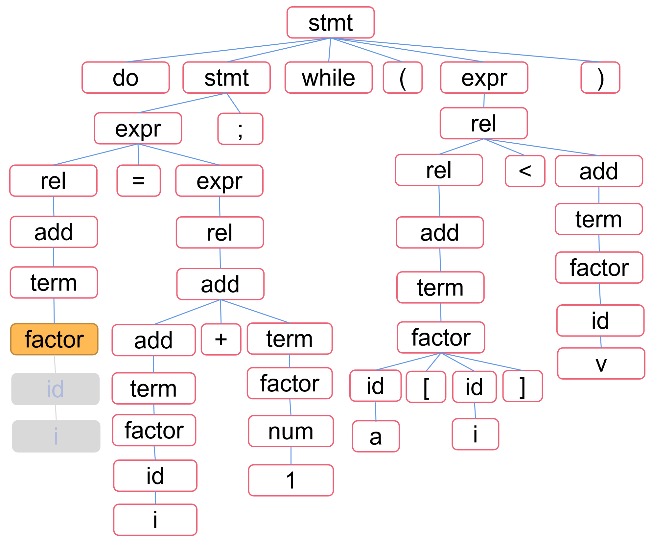
分析树=>AST Parsing Tree=>AST
 | 文法规则 / Grammar Rules |  |  | 语义动作 / Semantic Action
1 | program | → | block | { return block.n;}
2 | block | → | ‘{‘stmts ‘}’ | {block.n=stmts.n;}
3 | stmts | → | stmts1 | {stmts.n=new Seq(stmts1.n,stmt.n);}
4 |  |  | | ε | { stmts.n=null;}
5 | stmt | → | expr ‘;’ | {stmt.n=new Eval(expr.n);}
6 |  |  | | ‘if’‘(‘expr ‘)’stmt1 | {stmt.n=new If(expr.n, stmt1.n);}
7 |  |  | | ‘while' ‘(‘expr ‘)’stmt1 | {stmt.n=new While(expr.n, stmt1.n);}
8 |  |  | | ‘do’stmt1 ‘while’‘(‘expr ‘)’’;’ | {stmt.n=new Do(stmt1.n, expr.n);}
9 |  |  | | block | {stmt.n=block.n;}
10 | expr | → | rel ‘=’expr1 | {expr.n=new Assign(‘=’,rel.n,expr1.n);}
11 |  |  | | rel | {expr.n=rel.n;}
12 | rel | → | rel1 ‘<’add | {rel.n=new Rel(‘<’,rel1.n,add.n);}
13 |  |  | | ‘<=’add | {rel.n=new Rel(LE,rel1.n,add.n);}
14 |  |  | | add | {rel.n=add.n;}
15 | add | → | add1 ‘+’term | {add.n=new Op(‘+’,add1.n,term.n);}
16 |  |  | | term | {add.n=term.n;}
17 | term | → | term1 ‘*’factor | {term.n=new Op(‘*’,term1.n,factor.n);}
18 |  |  | | factor | {term.n=factor.n;}
19 | factor | → | ‘(‘expr ‘)’ | {factor.n=expr.n;}
20 |  |  | | num | {factor.n=new Num(num.value);}
21 |  |  | | id | {factor.n=new ID (id.text); }
22 |  |  | | id1 [ id2 ] | {factor.n=new Array(id1.text, id2.text);}
factor.n=ID(‘i’)
ID(‘i’)

Slide 22
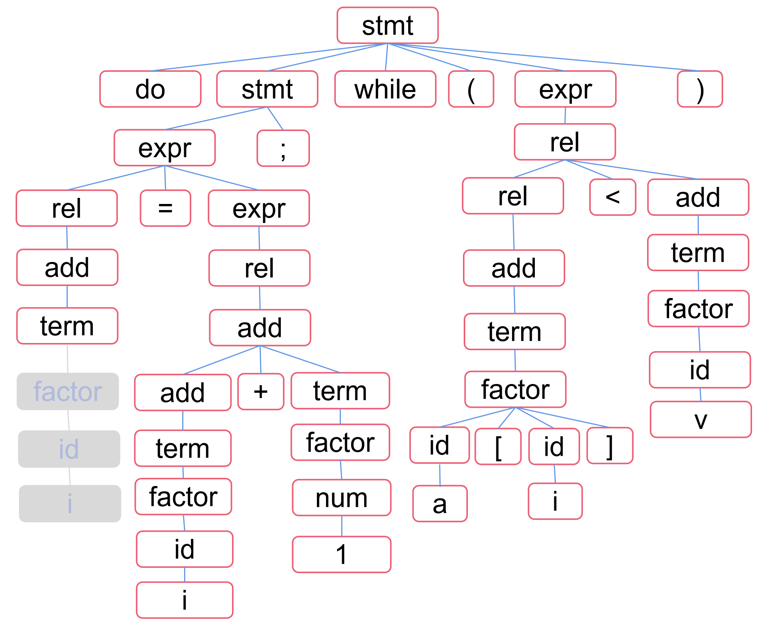
分析树=>AST Parsing Tree=>AST
 | 文法规则 / Grammar Rules |  |  | 语义动作 / Semantic Action
1 | program | → | block | { return block.n;}
2 | block | → | ‘{‘stmts ‘}’ | {block.n=stmts.n;}
3 | stmts | → | stmts1 | {stmts.n=new Seq(stmts1.n,stmt.n);}
4 |  |  | | ε | { stmts.n=null;}
5 | stmt | → | expr ‘;’ | {stmt.n=new Eval(expr.n);}
6 |  |  | | ‘if’‘(‘expr ‘)’stmt1 | {stmt.n=new If(expr.n, stmt1.n);}
7 |  |  | | ‘while' ‘(‘expr ‘)’stmt1 | {stmt.n=new While(expr.n, stmt1.n);}
8 |  |  | | ‘do’stmt1 ‘while’‘(‘expr ‘)’’;’ | {stmt.n=new Do(stmt1.n, expr.n);}
9 |  |  | | block | {stmt.n=block.n;}
10 | expr | → | rel ‘=’expr1 | {expr.n=new Assign(‘=’,rel.n,expr1.n);}
11 |  |  | | rel | {expr.n=rel.n;}
12 | rel | → | rel1 ‘<’add | {rel.n=new Rel(‘<’,rel1.n,add.n);}
13 |  |  | | ‘<=’add | {rel.n=new Rel(LE,rel1.n,add.n);}
14 |  |  | | add | {rel.n=add.n;}
15 | add | → | add1 ‘+’term | {add.n=new Op(‘+’,add1.n,term.n);}
16 |  |  | | term | {add.n=term.n;}
17 | term | → | term1 ‘*’factor | {term.n=new Op(‘*’,term1.n,factor.n);}
18 |  |  | | factor | {term.n=factor.n;}
19 | factor | → | ‘(‘expr ‘)’ | {factor.n=expr.n;}
20 |  |  | | num | {factor.n=new Num(num.value);}
21 |  |  | | id | {factor.n=new ID (id.text); }
22 |  |  | | id1 [ id2 ] | {factor.n=new Array(id1.text, id2.text);}
term.n=factor.n
ID(‘i’)

Slide 23
分析树=>AST Parsing Tree=>AST
 | 文法规则 / Grammar Rules |  |  | 语义动作 / Semantic Action
1 | program | → | block | { return block.n;}
2 | block | → | ‘{‘stmts ‘}’ | {block.n=stmts.n;}
3 | stmts | → | stmts1 | {stmts.n=new Seq(stmts1.n,stmt.n);}
4 |  |  | | ε | { stmts.n=null;}
5 | stmt | → | expr ‘;’ | {stmt.n=new Eval(expr.n);}
6 |  |  | | ‘if’‘(‘expr ‘)’stmt1 | {stmt.n=new If(expr.n, stmt1.n);}
7 |  |  | | ‘while' ‘(‘expr ‘)’stmt1 | {stmt.n=new While(expr.n, stmt1.n);}
8 |  |  | | ‘do’stmt1 ‘while’‘(‘expr ‘)’’;’ | {stmt.n=new Do(stmt1.n, expr.n);}
9 |  |  | | block | {stmt.n=block.n;}
10 | expr | → | rel ‘=’expr1 | {expr.n=new Assign(‘=’,rel.n,expr1.n);}
11 |  |  | | rel | {expr.n=rel.n;}
12 | rel | → | rel1 ‘<’add | {rel.n=new Rel(‘<’,rel1.n,add.n);}
13 |  |  | | ‘<=’add | {rel.n=new Rel(LE,rel1.n,add.n);}
14 |  |  | | add | {rel.n=add.n;}
15 | add | → | add1 ‘+’term | {add.n=new Op(‘+’,add1.n,term.n);}
16 |  |  | | term | {add.n=term.n;}
17 | term | → | term1 ‘*’factor | {term.n=new Op(‘*’,term1.n,factor.n);}
18 |  |  | | factor | {term.n=factor.n;}
19 | factor | → | ‘(‘expr ‘)’ | {factor.n=expr.n;}
20 |  |  | | num | {factor.n=new Num(num.value);}
21 |  |  | | id | {factor.n=new ID (id.text); }
22 |  |  | | id1 [ id2 ] | {factor.n=new Array(id1.text, id2.text);}
term.n=factor.n
ID(‘i’)

Slide 24
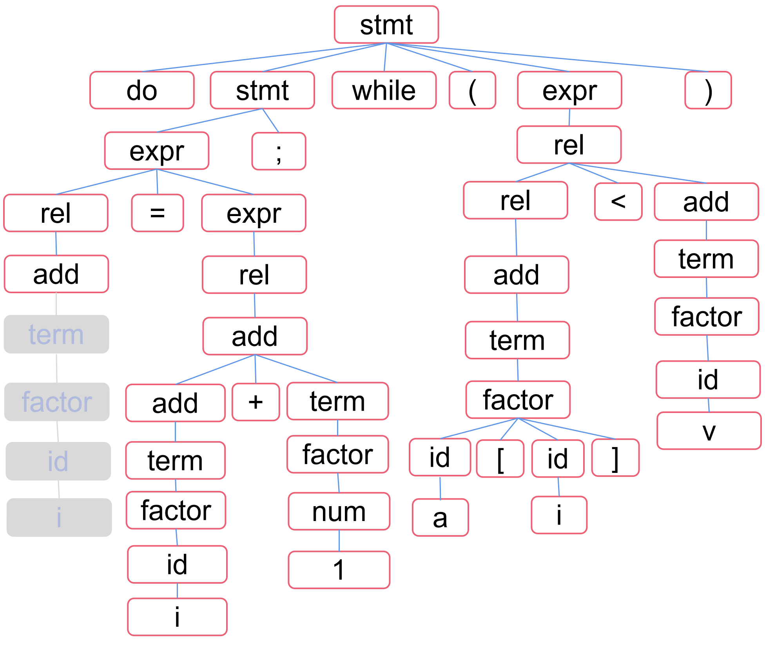
分析树=>AST Parsing Tree=>AST
 | 文法规则 / Grammar Rules |  |  | 语义动作 / Semantic Action
1 | program | → | block | { return block.n;}
2 | block | → | ‘{‘stmts ‘}’ | {block.n=stmts.n;}
3 | stmts | → | stmts1 | {stmts.n=new Seq(stmts1.n,stmt.n);}
4 |  |  | | ε | { stmts.n=null;}
5 | stmt | → | expr ‘;’ | {stmt.n=new Eval(expr.n);}
6 |  |  | | ‘if’‘(‘expr ‘)’stmt1 | {stmt.n=new If(expr.n, stmt1.n);}
7 |  |  | | ‘while' ‘(‘expr ‘)’stmt1 | {stmt.n=new While(expr.n, stmt1.n);}
8 |  |  | | ‘do’stmt1 ‘while’‘(‘expr ‘)’’;’ | {stmt.n=new Do(stmt1.n, expr.n);}
9 |  |  | | block | {stmt.n=block.n;}
10 | expr | → | rel ‘=’expr1 | {expr.n=new Assign(‘=’,rel.n,expr1.n);}
11 |  |  | | rel | {expr.n=rel.n;}
12 | rel | → | rel1 ‘<’add | {rel.n=new Rel(‘<’,rel1.n,add.n);}
13 |  |  | | ‘<=’add | {rel.n=new Rel(LE,rel1.n,add.n);}
14 |  |  | | add | {rel.n=add.n;}
15 | add | → | add1 ‘+’term | {add.n=new Op(‘+’,add1.n,term.n);}
16 |  |  | | term | {add.n=term.n;}
17 | term | → | term1 ‘*’factor | {term.n=new Op(‘*’,term1.n,factor.n);}
18 |  |  | | factor | {term.n=factor.n;}
19 | factor | → | ‘(‘expr ‘)’ | {factor.n=expr.n;}
20 |  |  | | num | {factor.n=new Num(num.value);}
21 |  |  | | id | {factor.n=new ID (id.text); }
22 |  |  | | id1 [ id2 ] | {factor.n=new Array(id1.text, id2.text);}
add.n=term.n
ID(‘i’)

Slide 25

分析树=>AST Parsing Tree=>AST
 | 文法规则 / Grammar Rules |  |  | 语义动作 / Semantic Action
1 | program | → | block | { return block.n;}
2 | block | → | ‘{‘stmts ‘}’ | {block.n=stmts.n;}
3 | stmts | → | stmts1 | {stmts.n=new Seq(stmts1.n,stmt.n);}
4 |  |  | | ε | { stmts.n=null;}
5 | stmt | → | expr ‘;’ | {stmt.n=new Eval(expr.n);}
6 |  |  | | ‘if’‘(‘expr ‘)’stmt1 | {stmt.n=new If(expr.n, stmt1.n);}
7 |  |  | | ‘while' ‘(‘expr ‘)’stmt1 | {stmt.n=new While(expr.n, stmt1.n);}
8 |  |  | | ‘do’stmt1 ‘while’‘(‘expr ‘)’’;’ | {stmt.n=new Do(stmt1.n, expr.n);}
9 |  |  | | block | {stmt.n=block.n;}
10 | expr | → | rel ‘=’expr1 | {expr.n=new Assign(‘=’,rel.n,expr1.n);}
11 |  |  | | rel | {expr.n=rel.n;}
12 | rel | → | rel1 ‘<’add | {rel.n=new Rel(‘<’,rel1.n,add.n);}
13 |  |  | | ‘<=’add | {rel.n=new Rel(LE,rel1.n,add.n);}
14 |  |  | | add | {rel.n=add.n;}
15 | add | → | add1 ‘+’term | {add.n=new Op(‘+’,add1.n,term.n);}
16 |  |  | | term | {add.n=term.n;}
17 | term | → | term1 ‘*’factor | {term.n=new Op(‘*’,term1.n,factor.n);}
18 |  |  | | factor | {term.n=factor.n;}
19 | factor | → | ‘(‘expr ‘)’ | {factor.n=expr.n;}
20 |  |  | | num | {factor.n=new Num(num.value);}
21 |  |  | | id | {factor.n=new ID (id.text); }
22 |  |  | | id1 [ id2 ] | {factor.n=new Array(id1.text, id2.text);}
rel.n=add.n
ID(‘i’)

Slide 26
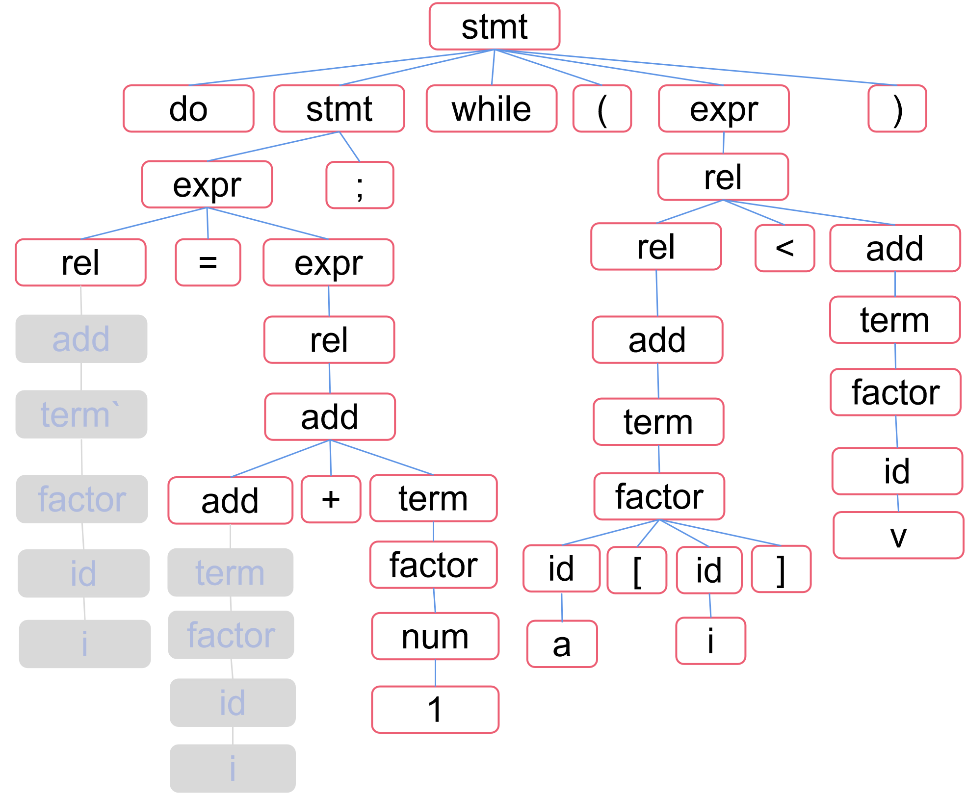
分析树=>AST Parsing Tree=>AST
 | 文法规则 / Grammar Rules |  |  | 语义动作 / Semantic Action
1 | program | → | block | { return block.n;}
2 | block | → | ‘{‘stmts ‘}’ | {block.n=stmts.n;}
3 | stmts | → | stmts1 | {stmts.n=new Seq(stmts1.n,stmt.n);}
4 |  |  | | ε | { stmts.n=null;}
5 | stmt | → | expr ‘;’ | {stmt.n=new Eval(expr.n);}
6 |  |  | | ‘if’‘(‘expr ‘)’stmt1 | {stmt.n=new If(expr.n, stmt1.n);}
7 |  |  | | ‘while' ‘(‘expr ‘)’stmt1 | {stmt.n=new While(expr.n, stmt1.n);}
8 |  |  | | ‘do’stmt1 ‘while’‘(‘expr ‘)’’;’ | {stmt.n=new Do(stmt1.n, expr.n);}
9 |  |  | | block | {stmt.n=block.n;}
10 | expr | → | rel ‘=’expr1 | {expr.n=new Assign(‘=’,rel.n,expr1.n);}
11 |  |  | | rel | {expr.n=rel.n;}
12 | rel | → | rel1 ‘<’add | {rel.n=new Rel(‘<’,rel1.n,add.n);}
13 |  |  | | ‘<=’add | {rel.n=new Rel(LE,rel1.n,add.n);}
14 |  |  | | add | {rel.n=add.n;}
15 | add | → | add1 ‘+’term | {add.n=new Op(‘+’,add1.n,term.n);}
16 |  |  | | term | {add.n=term.n;}
17 | term | → | term1 ‘*’factor | {term.n=new Op(‘*’,term1.n,factor.n);}
18 |  |  | | factor | {term.n=factor.n;}
19 | factor | → | ‘(‘expr ‘)’ | {factor.n=expr.n;}
20 |  |  | | num | {factor.n=new Num(num.value);}
21 |  |  | | id | {factor.n=new ID (id.text); }
22 |  |  | | id1 [ id2 ] | {factor.n=new Array(id1.text, id2.text);}
rel.n=add.n
add.n=term.n
ID(‘i’)
ID(‘i’)

Slide 27
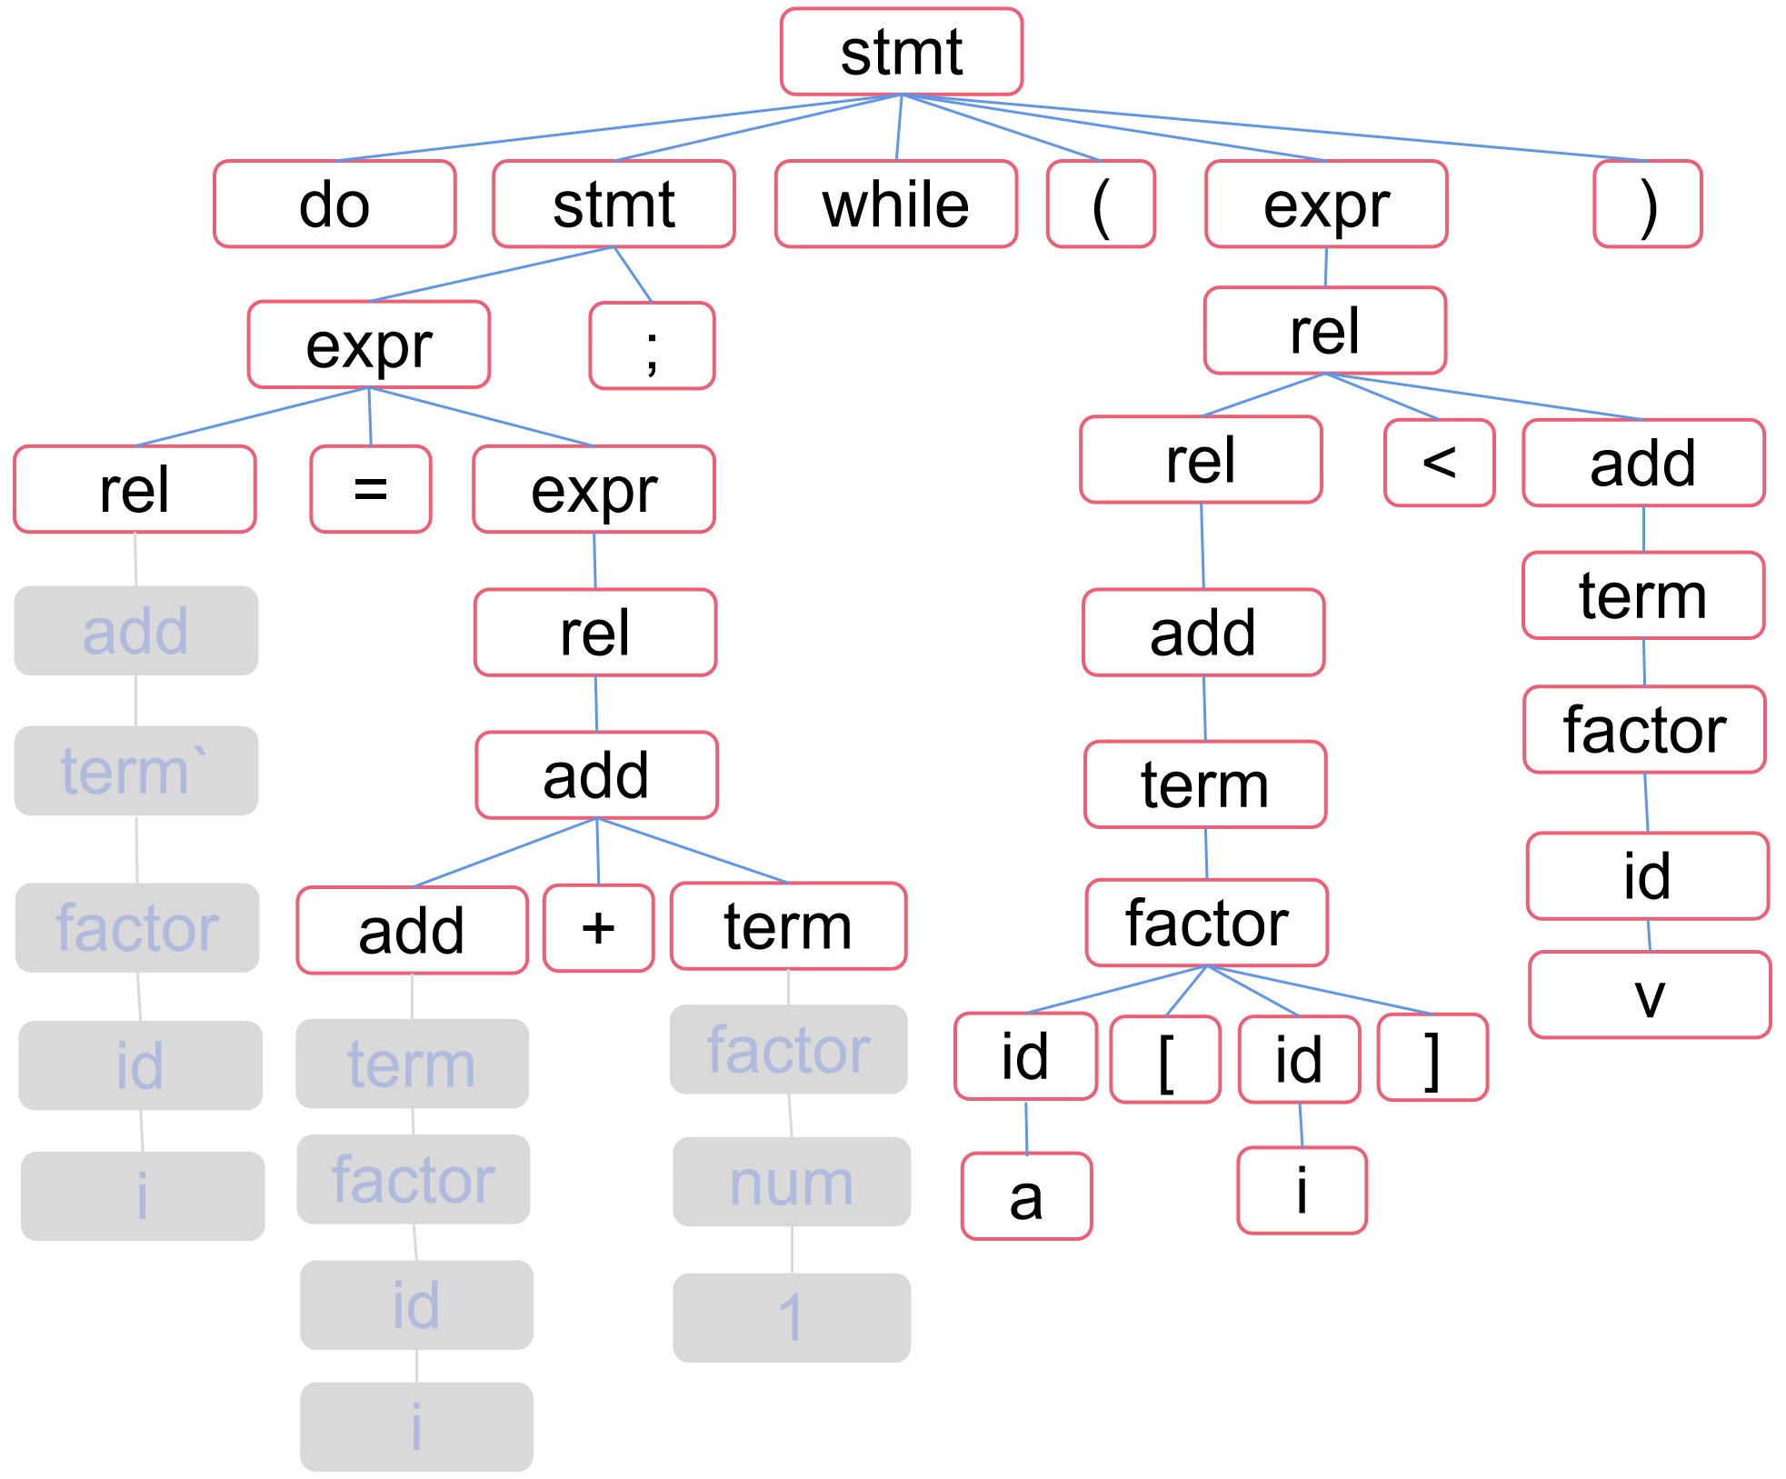
分析树=>AST Parsing Tree=>AST
 | 文法规则 / Grammar Rules |  |  | 语义动作 / Semantic Action
1 | program | → | block | { return block.n;}
2 | block | → | ‘{‘stmts ‘}’ | {block.n=stmts.n;}
3 | stmts | → | stmts1 | {stmts.n=new Seq(stmts1.n,stmt.n);}
4 |  |  | | ε | { stmts.n=null;}
5 | stmt | → | expr ‘;’ | {stmt.n=new Eval(expr.n);}
6 |  |  | | ‘if’‘(‘expr ‘)’stmt1 | {stmt.n=new If(expr.n, stmt1.n);}
7 |  |  | | ‘while' ‘(‘expr ‘)’stmt1 | {stmt.n=new While(expr.n, stmt1.n);}
8 |  |  | | ‘do’stmt1 ‘while’‘(‘expr ‘)’’;’ | {stmt.n=new Do(stmt1.n, expr.n);}
9 |  |  | | block | {stmt.n=block.n;}
10 | expr | → | rel ‘=’expr1 | {expr.n=new Assign(‘=’,rel.n,expr1.n);}
11 |  |  | | rel | {expr.n=rel.n;}
12 | rel | → | rel1 ‘<’add | {rel.n=new Rel(‘<’,rel1.n,add.n);}
13 |  |  | | ‘<=’add | {rel.n=new Rel(LE,rel1.n,add.n);}
14 |  |  | | add | {rel.n=add.n;}
15 | add | → | add1 ‘+’term | {add.n=new Op(‘+’,add1.n,term.n);}
16 |  |  | | term | {add.n=term.n;}
17 | term | → | term1 ‘*’factor | {term.n=new Op(‘*’,term1.n,factor.n);}
18 |  |  | | factor | {term.n=factor.n;}
19 | factor | → | ‘(‘expr ‘)’ | {factor.n=expr.n;}
20 |  |  | | num | {factor.n=new Num(num.value);}
21 |  |  | | id | {factor.n=new ID (id.text); }
22 |  |  | | id1 [ id2 ] | {factor.n=new Array(id1.text, id2.text);}
rel.n=add.n
term.n=factor.n
add.n=term.n
ID(‘i’)
ID(‘i’)
Num(1)

Slide 28
分析树=>AST Parsing Tree=>AST
 | 文法规则 / Grammar Rules |  |  | 语义动作 / Semantic Action
1 | program | → | block | { return block.n;}
2 | block | → | ‘{‘stmts ‘}’ | {block.n=stmts.n;}
3 | stmts | → | stmts1 | {stmts.n=new Seq(stmts1.n,stmt.n);}
4 |  |  | | ε | { stmts.n=null;}
5 | stmt | → | expr ‘;’ | {stmt.n=new Eval(expr.n);}
6 |  |  | | ‘if’‘(‘expr ‘)’stmt1 | {stmt.n=new If(expr.n, stmt1.n);}
7 |  |  | | ‘while' ‘(‘expr ‘)’stmt1 | {stmt.n=new While(expr.n, stmt1.n);}
8 |  |  | | ‘do’stmt1 ‘while’‘(‘expr ‘)’’;’ | {stmt.n=new Do(stmt1.n, expr.n);}
9 |  |  | | block | {stmt.n=block.n;}
10 | expr | → | rel ‘=’expr1 | {expr.n=new Assign(‘=’,rel.n,expr1.n);}
11 |  |  | | rel | {expr.n=rel.n;}
12 | rel | → | rel1 ‘<’add | {rel.n=new Rel(‘<’,rel1.n,add.n);}
13 |  |  | | ‘<=’add | {rel.n=new Rel(LE,rel1.n,add.n);}
14 |  |  | | add | {rel.n=add.n;}
15 | add | → | add1 ‘+’term | {add.n=new Op(‘+’,add1.n,term.n);}
16 |  |  | | term | {add.n=term.n;}
17 | term | → | term1 ‘*’factor | {term.n=new Op(‘*’,term1.n,factor.n);}
18 |  |  | | factor | {term.n=factor.n;}
19 | factor | → | ‘(‘expr ‘)’ | {factor.n=expr.n;}
20 |  |  | | num | {factor.n=new Num(num.value);}
21 |  |  | | id | {factor.n=new ID (id.text); }
22 |  |  | | id1 [ id2 ] | {factor.n=new Array(id1.text, id2.text);}
rel.n=add.n
add.n=OP(‘+’)
OP(‘+’)
add.n=term.n
term.n=factor.n
ID(‘i’)
ID(‘i’)
Num(1)

Slide 29
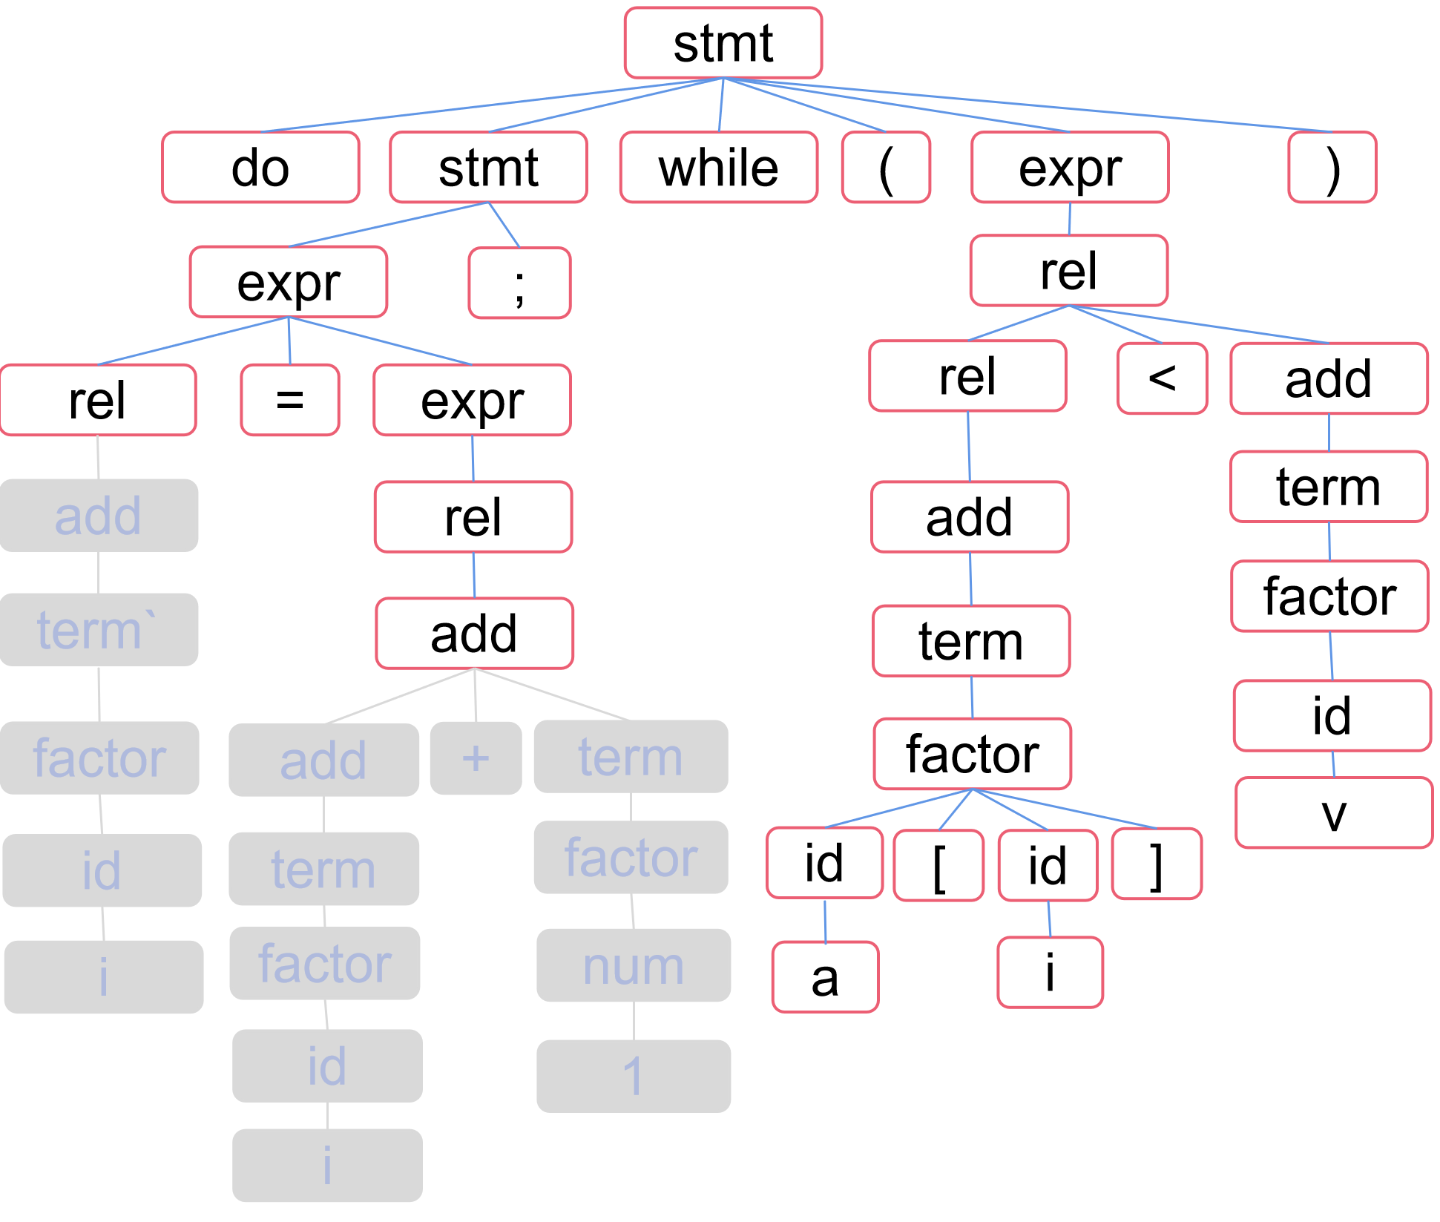
分析树=>AST Parsing Tree=>AST
 | 文法规则 / Grammar Rules |  |  | 语义动作 / Semantic Action
1 | program | → | block | { return block.n;}
2 | block | → | ‘{‘stmts ‘}’ | {block.n=stmts.n;}
3 | stmts | → | stmts1 | {stmts.n=new Seq(stmts1.n,stmt.n);}
4 |  |  | | ε | { stmts.n=null;}
5 | stmt | → | expr ‘;’ | {stmt.n=new Eval(expr.n);}
6 |  |  | | ‘if’‘(‘expr ‘)’stmt1 | {stmt.n=new If(expr.n, stmt1.n);}
7 |  |  | | ‘while' ‘(‘expr ‘)’stmt1 | {stmt.n=new While(expr.n, stmt1.n);}
8 |  |  | | ‘do’stmt1 ‘while’‘(‘expr ‘)’’;’ | {stmt.n=new Do(stmt1.n, expr.n);}
9 |  |  | | block | {stmt.n=block.n;}
10 | expr | → | rel ‘=’expr1 | {expr.n=new Assign(‘=’,rel.n,expr1.n);}
11 |  |  | | rel | {expr.n=rel.n;}
12 | rel | → | rel1 ‘<’add | {rel.n=new Rel(‘<’,rel1.n,add.n);}
13 |  |  | | ‘<=’add | {rel.n=new Rel(LE,rel1.n,add.n);}
14 |  |  | | add | {rel.n=add.n;}
15 | add | → | add1 ‘+’term | {add.n=new Op(‘+’,add1.n,term.n);}
16 |  |  | | term | {add.n=term.n;}
17 | term | → | term1 ‘*’factor | {term.n=new Op(‘*’,term1.n,factor.n);}
18 |  |  | | factor | {term.n=factor.n;}
19 | factor | → | ‘(‘expr ‘)’ | {factor.n=expr.n;}
20 |  |  | | num | {factor.n=new Num(num.value);}
21 |  |  | | id | {factor.n=new ID (id.text); }
22 |  |  | | id1 [ id2 ] | {factor.n=new Array(id1.text, id2.text);}
rel.n=add.n
add.n=OP(‘+’)
OP(‘+’)
term.n=factor.n
add.n=term.n
term.n=factor.n
add.n=term.n
ID(‘i’)
ID(‘i’)
Num(1)

Slide 30
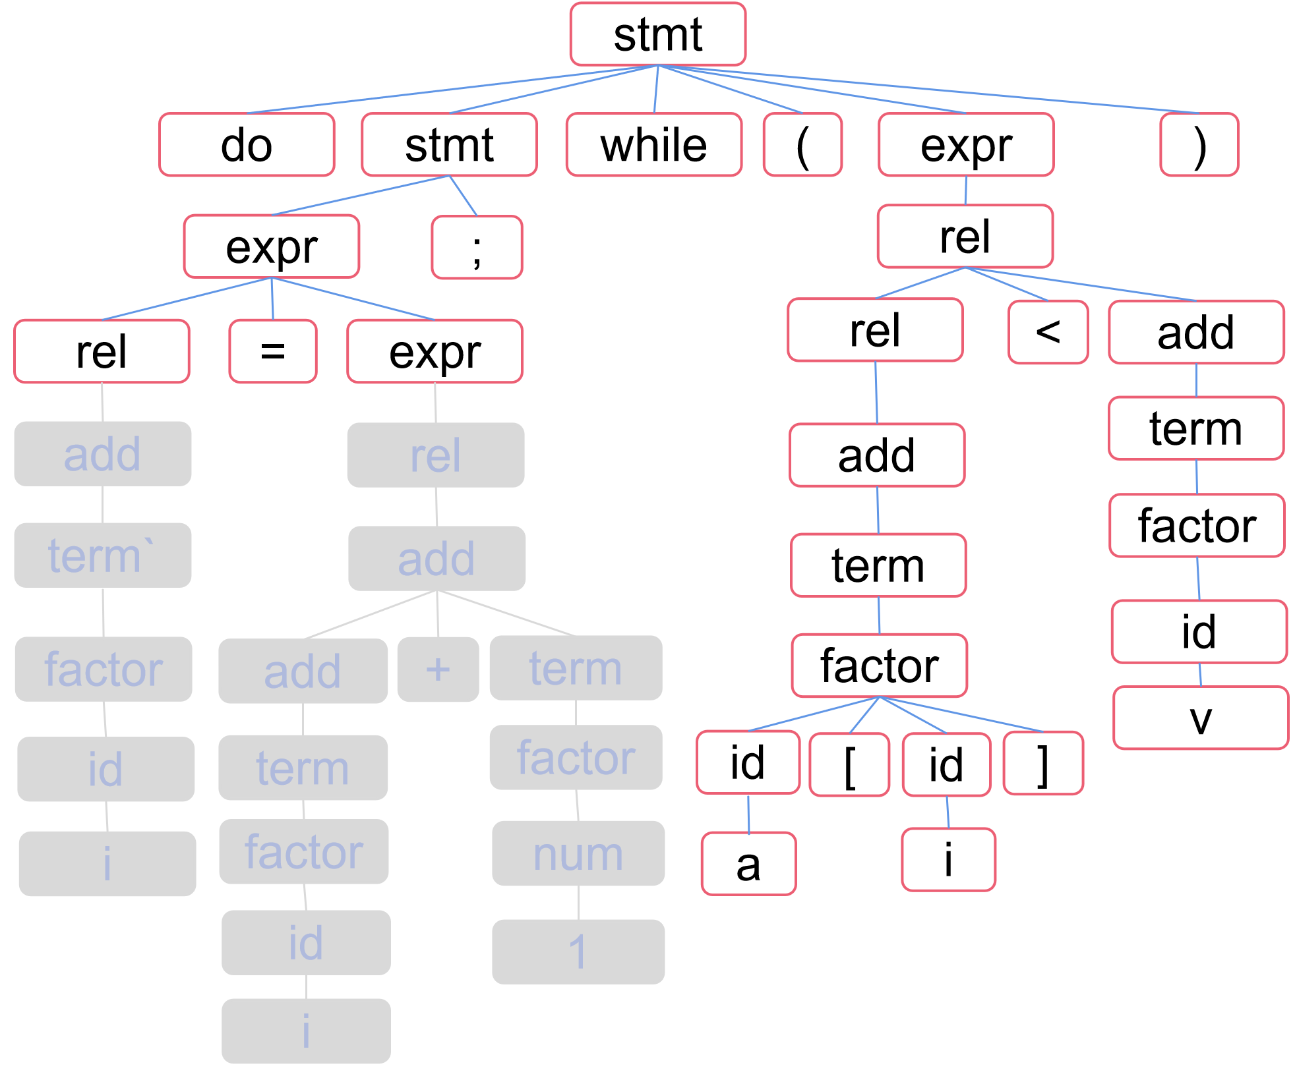
分析树=>AST Parsing Tree=>AST
 | 文法规则 / Grammar Rules |  |  | 语义动作 / Semantic Action
1 | program | → | block | { return block.n;}
2 | block | → | ‘{‘stmts ‘}’ | {block.n=stmts.n;}
3 | stmts | → | stmts1 | {stmts.n=new Seq(stmts1.n,stmt.n);}
4 |  |  | | ε | { stmts.n=null;}
5 | stmt | → | expr ‘;’ | {stmt.n=new Eval(expr.n);}
6 |  |  | | ‘if’‘(‘expr ‘)’stmt1 | {stmt.n=new If(expr.n, stmt1.n);}
7 |  |  | | ‘while' ‘(‘expr ‘)’stmt1 | {stmt.n=new While(expr.n, stmt1.n);}
8 |  |  | | ‘do’stmt1 ‘while’‘(‘expr ‘)’’;’ | {stmt.n=new Do(stmt1.n, expr.n);}
9 |  |  | | block | {stmt.n=block.n;}
10 | expr | → | rel ‘=’expr1 | {expr.n=new Assign(‘=’,rel.n,expr1.n);}
11 |  |  | | rel | {expr.n=rel.n;}
12 | rel | → | rel1 ‘<’add | {rel.n=new Rel(‘<’,rel1.n,add.n);}
13 |  |  | | ‘<=’add | {rel.n=new Rel(LE,rel1.n,add.n);}
14 |  |  | | add | {rel.n=add.n;}
15 | add | → | add1 ‘+’term | {add.n=new Op(‘+’,add1.n,term.n);}
16 |  |  | | term | {add.n=term.n;}
17 | term | → | term1 ‘*’factor | {term.n=new Op(‘*’,term1.n,factor.n);}
18 |  |  | | factor | {term.n=factor.n;}
19 | factor | → | ‘(‘expr ‘)’ | {factor.n=expr.n;}
20 |  |  | | num | {factor.n=new Num(num.value);}
21 |  |  | | id | {factor.n=new ID (id.text); }
22 |  |  | | id1 [ id2 ] | {factor.n=new Array(id1.text, id2.text);}
rel.n=add.n
expr.n=rel.n
OP(‘+’)
ID(‘i’)
ID(‘i’)
Num(1)

Slide 31
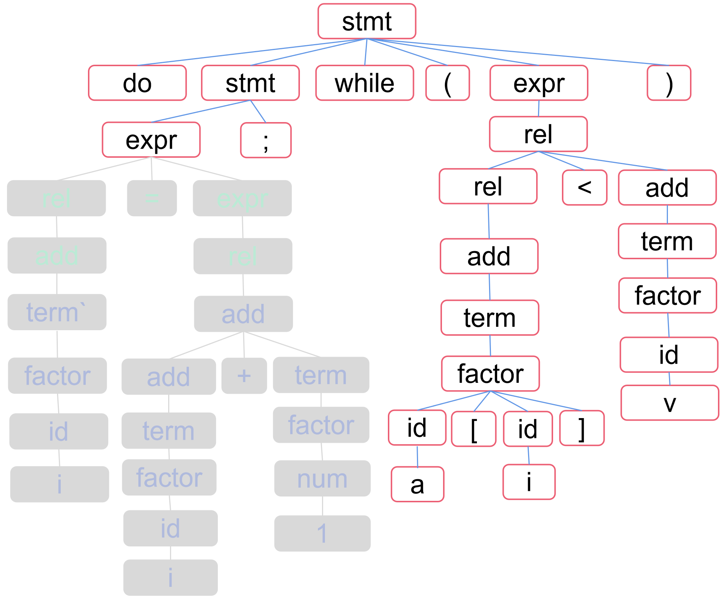
分析树=>AST Parsing Tree=>AST
 | 文法规则 / Grammar Rules |  |  | 语义动作 / Semantic Action
1 | program | → | block | { return block.n;}
2 | block | → | ‘{‘stmts ‘}’ | {block.n=stmts.n;}
3 | stmts | → | stmts1 | {stmts.n=new Seq(stmts1.n,stmt.n);}
4 |  |  | | ε | { stmts.n=null;}
5 | stmt | → | expr ‘;’ | {stmt.n=new Eval(expr.n);}
6 |  |  | | ‘if’‘(‘expr ‘)’stmt1 | {stmt.n=new If(expr.n, stmt1.n);}
7 |  |  | | ‘while' ‘(‘expr ‘)’stmt1 | {stmt.n=new While(expr.n, stmt1.n);}
8 |  |  | | ‘do’stmt1 ‘while’‘(‘expr ‘)’’;’ | {stmt.n=new Do(stmt1.n, expr.n);}
9 |  |  | | block | {stmt.n=block.n;}
10 | expr | → | rel ‘=’expr1 | {expr.n=new Assign(‘=’,rel.n,expr1.n);}
11 |  |  | | rel | {expr.n=rel.n;}
12 | rel | → | rel1 ‘<’add | {rel.n=new Rel(‘<’,rel1.n,add.n);}
13 |  |  | | ‘<=’add | {rel.n=new Rel(LE,rel1.n,add.n);}
14 |  |  | | add | {rel.n=add.n;}
15 | add | → | add1 ‘+’term | {add.n=new Op(‘+’,add1.n,term.n);}
16 |  |  | | term | {add.n=term.n;}
17 | term | → | term1 ‘*’factor | {term.n=new Op(‘*’,term1.n,factor.n);}
18 |  |  | | factor | {term.n=factor.n;}
19 | factor | → | ‘(‘expr ‘)’ | {factor.n=expr.n;}
20 |  |  | | num | {factor.n=new Num(num.value);}
21 |  |  | | id | {factor.n=new ID (id.text); }
22 |  |  | | id1 [ id2 ] | {factor.n=new Array(id1.text, id2.text);}
expr.n=
Assign(‘=’, ‘i’ , OP(‘+’))
Assign(=+’)
OP(‘+’)
ID(‘i’)
ID(‘i’)
Num(1)

Slide 32
AST=>三地址码（四元式） AST=>Three address code
编译器设计（第2版）by Cooper，pp.254
Engineering a Compiler (2nd) by Cooper, pp.254
(1)expr(node)
(2) int result, t1, t2;
(3) switch(type(node))
(4) case ‘+’：t1=expr(leftchild(node));//左孩子
(5) t2=expr(rightchild(node));//右孩子
(6) result=NextRegister();
(7) print(op(node),t1,t2,result);
(8) break;
(9) case ID：t1=base(node);
(10) t2=offset(node);
(11) result=NextRegister();
(12) print(loadA0,t1,t2,result);
(13) break;
(14) case Num: result=NextRegister();
(15) print(loadI,val(node),none,result);
(16) break;
(17) return result;

Slide 33
AST=>三地址码（四元式）：算术表达式（手写说明/Explain) AST=>Three address code：Expression （无寄存器与寻址模式的简单版本/Simple Version without register & address mode)
编译器设计（第2版）by Cooper，pp.254
Engineering a Compiler (2nd) by Cooper, pp.254
简化版（生成简单的三地址码）/simple version(simple threess address code)
假定所有变量都有全局唯一的数字编号（用id2num函数获得）
Suppose all variables have a unique global digital numbering.
Suppose the unique number of id can be get with id2num() function.
NextTempNewVar()生成一个新的局部变量
NextTempNewVar() create a new temporary variable id.
(1)expr(node)
(2) int result, t1, t2;
(3) switch(type(node))
(4) case ‘+’：t1=expr(leftchild(node));//访问左孩子
(5) t2=expr(rightchild(node));//访问右孩子
(6) result=NextTempNewVar();
(7) print(op(node),t1,t2,result);
(8) break;
(9) case ID：result=id2num(node);
(10) break;
(11) case Num: result= val(node);
(12) break;
(13) return result;
+
a
+
b
3
(1)不管寻址模式的简单三地址码
Simple three address code (no address mode).
t1=b+3;
t2=a+t1;
****对应的四元式形式的三地址码
Quadruple form of TAC code)
( +, b, 3, t1)
( +, a, t1, t2)

Slide 34
AST=>三地址码（四元式）：算术表达式（手写说明/Explain) AST=>Three address code：Expression （使用寄存器的简单版本/Simple Version with register)
编译器设计（第2版）by Cooper，pp.254
Engineering a Compiler (2nd) by Cooper, pp.254
简化版（生成简单的三地址码）/simple version(simple threess address code)
假定有无限多个虚拟寄存器，每个虚拟寄存器有全局唯一编号。
Suppose there are infinite virtual registers (each has unique global num).
id节点的文本可通过text(node)得到 / text(node) can get text of id node.
(1)expr(node)
(2) int result, t1, t2;
(3) switch(type(node))
(4) case ‘+’：t1=expr(leftchild(node));//访问左孩子
(5) t2=expr(rightchild(node));//访问右孩子
(6) result=NextRegister();
(7) print(op(node),t1,t2,result);
(8) break;
(9) case ID：result=NextRegister(node);
(10) print(”=”,text(node), none ,result);
(13) break;
(14) case Num: result=NextRegister();
(15) print(”=”,val(node),none,result);
(16) break;
(17) return result;
+
a
+
b
3
(1)使用虚拟寄存器的简单三地址码
Simple three address code (with virtual registers).
R1=a;
R2=b;
R3=R2+3;
R4=R1+R3; //
****对应的四元式形式的三地址码
Quadruple form of TAC code)
( =, a, , R1)
( =, b, , R2)
(+, R2, 3, R3)
(+, R1, R3, R4)

Slide 35
AST=>三地址码（四元式）：算术表达式（手写说明/Explain) AST=>Three address code：Expression （使用寄存器&存储管理的简单版本/Simple Version with register & storage management)
编译器设计（第2版）by Cooper，pp.254
Engineering a Compiler (2nd) by Cooper, pp.254
(1)expr(node)
(2) int result, t1, t2;
(3) switch(type(node))
(4) case ‘+’：t1=expr(leftchild(node));//左孩子
(5) t2=expr(rightchild(node));//右孩子
(6) result=NextRegister();
(7) print(op(node),t1,t2,result);
(8) break;
(9) case ID：t1=base(node);
(10) t2=offset(node);
(11) result=NextRegister();
(12) print(loadA0,t1,t2,result);
(13) break;
(14) case Num: result=NextRegister();
(15) print(loadI,val(node),none,result);
(16) break;
(17) return result;
+
a
+
b
3
(1) loadA0 base(a), offset(a), R1
(2) loadA0 base(b), offset(b), R2
(3) loadI 3, R3
(4) add R2, R3, R4
(5) add R1, R4, R5

Slide 36
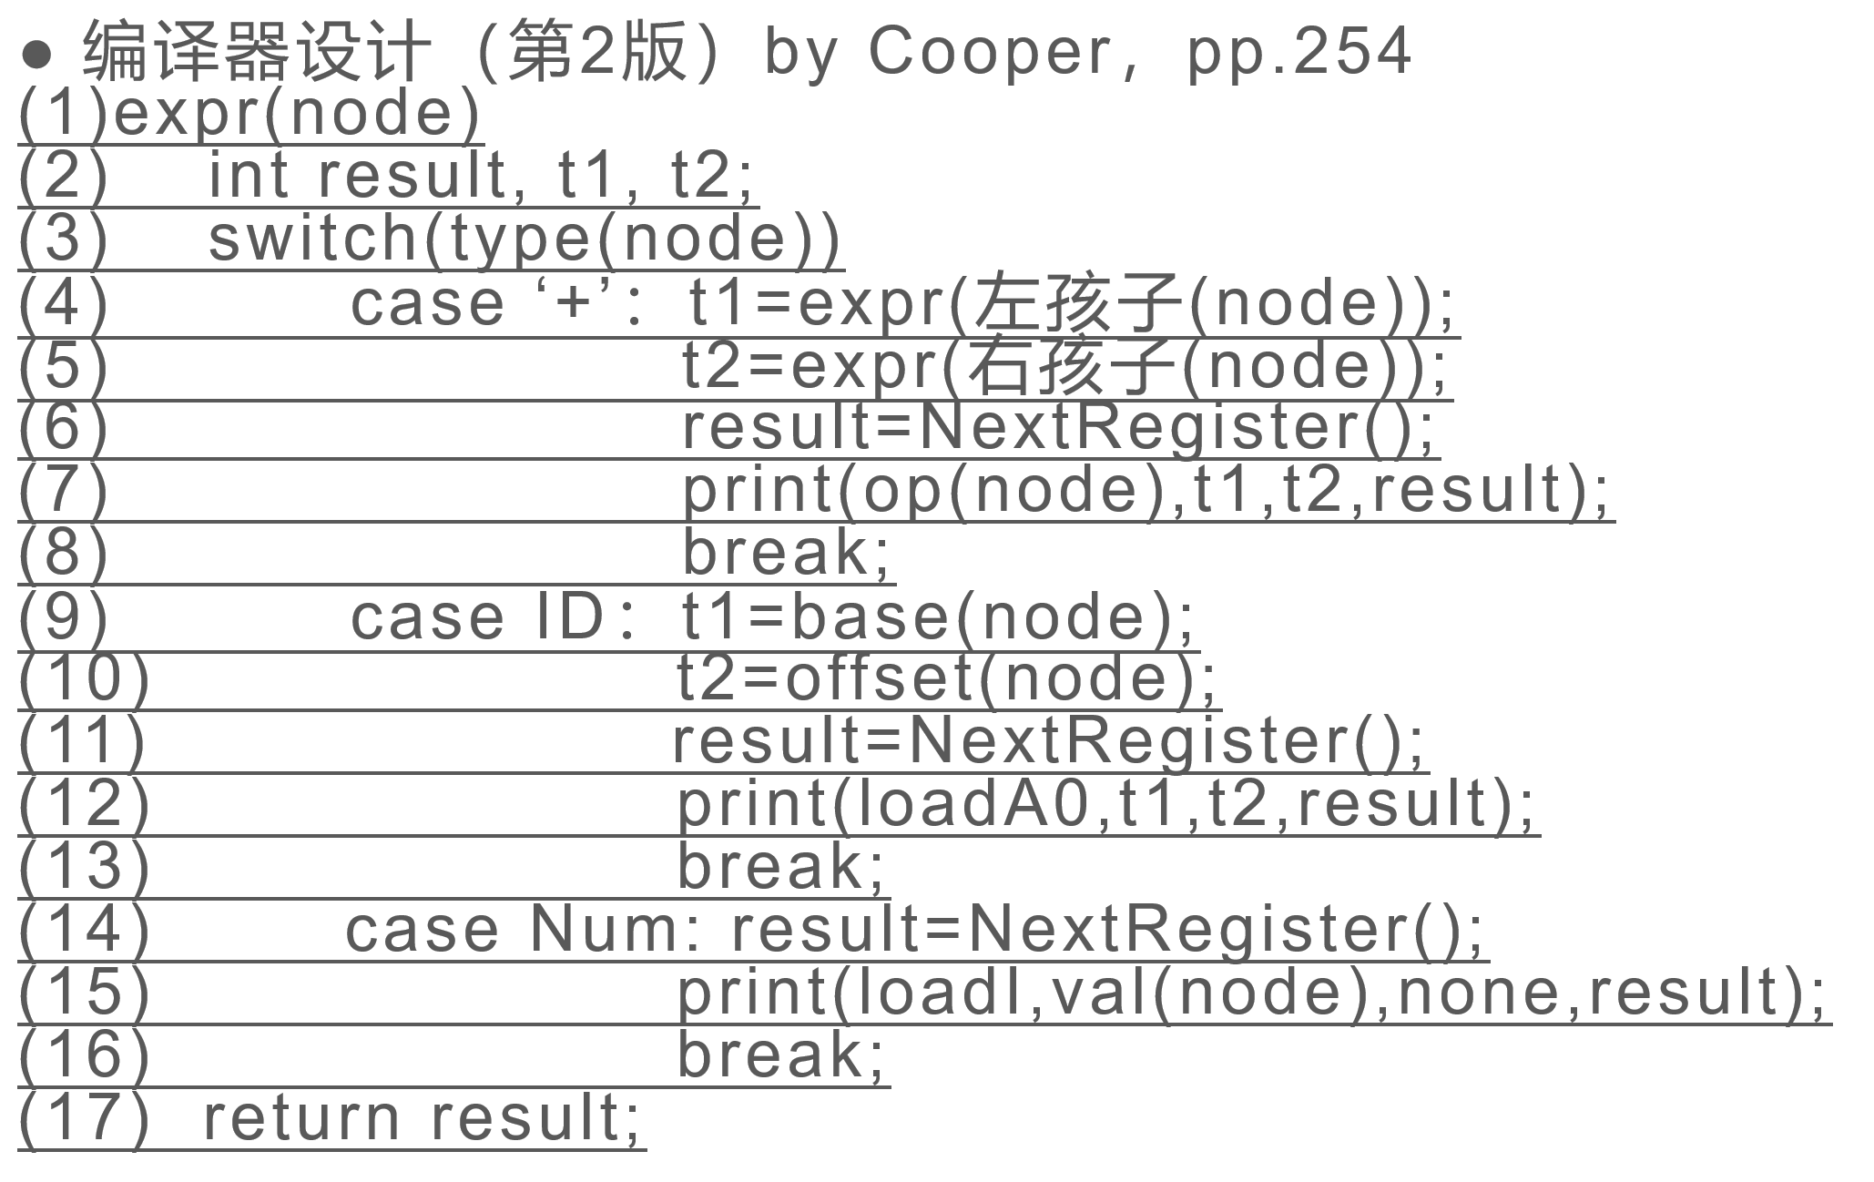
AST=>三地址码（四元式）：算术表达式（手写说明/Explain) AST=>Three address code：Expression
1
2
8
3
9
5
11
4
10
10
6
7

Slide 37
AST=>三地址码（四元式）：布尔表达式与控制流语句 AST=>Three address code：boolean exp & control flow statement
while-do？树结构修改——while(cond,body)
布尔表达式计算顺序（遍历顺序，决定了计算顺序）
1
2
8
3
9
5
11
4
10
10
6
7

Slide 38
AST=>三地址码（四元式）：布尔表达式与控制流语句 AST=>Three address code：boolean exp & control flow statement
while-do？树结构修改——while(cond,body)
布尔表达式计算顺序（遍历顺序，决定了计算顺序）
1
方式1：跳转 / Approach 1：Jump
L1: i=i+1
L2: t1=a[i]
L3: if(t1<v) goto L1
2
8
3
9
5
11
4
方式2：求值 / Approach 2：Calculate boolean Value
L1: i=i+1
L2: t1=a[i]
L3: t2=(t1 < v)
L4: if(t2==TRUE) goto L1
10
10
6
7

Slide 39
AST=>三地址码（四元式）：布尔表达式与控制流语句 AST=>Three address code：boolean exp & control flow statement
(1) int f ( int *p)
(2) {
(3) if( p!=NULL && *p<9)
(4) x=0;
(5) ....
(6) }
方式2：求值 / Approach 2：Calculate boolean Value
L1: t1=(p!=NULL);
L2: t2=(*p<9);
L3: t3=(t1 && t2);
L4: if(t3==TRUE) goto L5;
L5: x=0;
方式1是短路求值
Approach 2 is short circuiting
L1：if(p!=NULL) goto L3;
L2: goto Lout;
L3: if(*p<9) goto L5;
L4: goto Lout
L5: x=0;
Lout:？

Slide 40
AST=>三地址码（四元式）：布尔表达式与控制流语句 AST=>Three address code：boolean exp & control flow statement
(1) int x=4, y=0;
(2) int f() {
(3) x++;
(4) printf(“x=%d\n”,x);
(5) return 0;
(6)
(7) int main() {
(8) if(f()!=0&&f()<5)
(9) y=1;
(10) }
(8) if(f()!=0 && f()<5)
方式2：求值 / Approach 2：Calculate boolean Value
L1：t1=f()
L2：t2=(t1!=0)
L3：t3=f()
L4：t4=(t3<5)
L5：t5=(t2&&t4)
L6：if(t5==TRUE) goto L_true
L7：goto L_false
L_true：y=1
程序输出/Program Output
x=5
x=6
方式1是短路求值
Approach 2 is short circuiting
L1：t1=f()
L2：if(t1!=0) goto L4
L3：goto L_false
L4：t2=f()
L5：if(t2<5) goto L_true
L6：goto L_false
L_true：y=1
方式1是短路求值
x=5

Slide 41
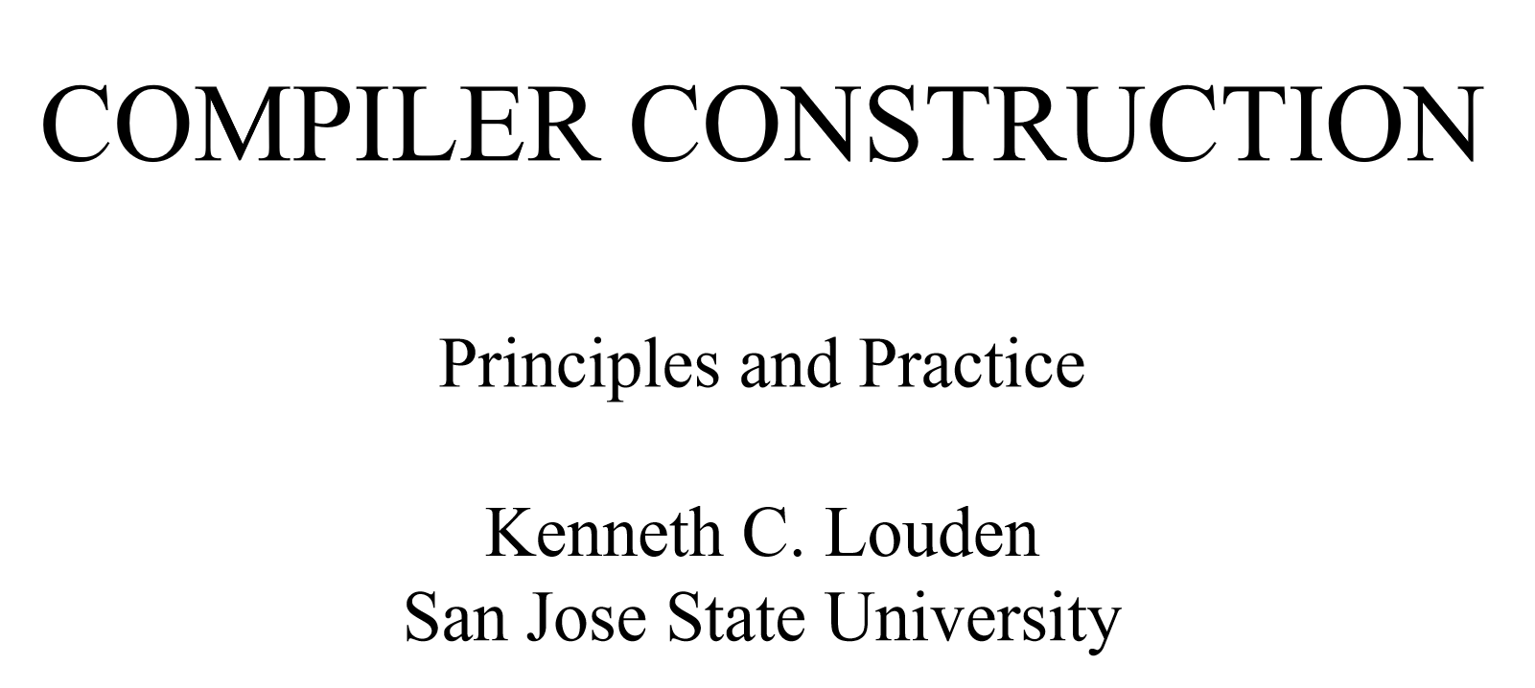
优化与代码生成简介 Intro to Optimization & Code Generation

Slide 42
优化与代码生成简介（from slides of Prof. Kenneth Louden） Intro to Optimization & Code Generation
Syntax analysis: it determines the structure of the program
The results of syntax analysis are a parse tree or a syntax tree
An example: a[index]=4+2
Parse tree
Syntax tree ( abstract syntax tree)

Slide 43
The Parse Tree （from slides of Prof. Kenneth Louden）
expression
Assign-expression
expression = expression
subscript-expression additive-expression
Expression [ expression ] expression + expression
identifier identifier number number
a index 4 2

Slide 44
The Abstract Syntax Tree （from slides of Prof. Kenneth Louden）
Assign-expression
subscript-expression additive-expression
identifier identifier number number
a index 4 2

Slide 45
The Source Code Optimizer/源代码优化器 （from slides of Prof. Kenneth Louden）
The earliest point of most optimization steps is just after semantic analysis / 语义分析后的早期优化
The code improvement depends only on the source code, and as a separate phase / 仅针对源程序进行优化
Individual compilers exhibit a wide variation in optimization kinds as well as placement
An example: a[index]=4+2 （例子）
Constant folding performed directly on annotated tree / 常量折叠
Using intermediate code: three-address code, p-code/针对中间代码

Slide 46
Optimizations on Annotated Tree(before optimize) / 语法树优化（优化前） （from slides of Prof. Kenneth Louden）
Assign-expression
subscript-expression additive-expression
integer integer
identifier identifier number number
a index 4 2
array of integer integer integer integer

Slide 47
Optimizations on Annotated Tree(after optimize) / 语法树优化（优化后） （from slides of Prof. Kenneth Louden）
Assign-expression
subscript-expression
integer
identifier identifier number
a index 6
array of integer integer integer

Slide 48
Optimization on Intermediate Code / 中间代码优化 （from slides of Prof. Kenneth Louden）
t = 4 + 2
a[index]=t
t = 6
a[index]=t
a[index]=6
RETURN

Slide 49
The Code Generate / 代码生成 （from slides of Prof. Kenneth Louden）
It takes the intermediate code or IR and generates code for target machine / 将中间代码或其他IR翻译为目标机指令
The properties of the target machine become the major factor / 必须考虑目标机器的特性:
Using instructions and representation of data / 选择适当指令和数据表示方式
An example: a[index]=4+2
Code sequence in a hypothetical assembly language

Slide 50
A possible code sequence / 假定汇编语言的结果 （from slides of Prof. Kenneth Louden）
MOV R0, index
MUL R0,2
MOV R1,&a
ADD R1,R0
MOV *R1,6
a[index]=6
RETURN

Slide 51
The Target Code Optimizer / 目标机代码优化 （from slides of Prof. Kenneth Louden）
It improves the target code generated by the code generator:
Address modes choosing / 选择适当的寻址模式
Instructions replacing /指令替换
As well as redundant eliminating / 冗余消除
MOV R0, index
MUL R0,2
MOV R1,&a
ADD R1,R0
MOV *R1,6
MOV R0, index
SHL R0
MOV &a[R1],6
BACK

Slide 52
龙书第二章剩余部分 Rest part of Dragon book Chapter 2

Slide 54
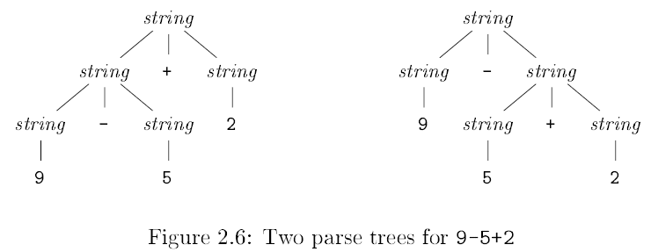

Slide 57
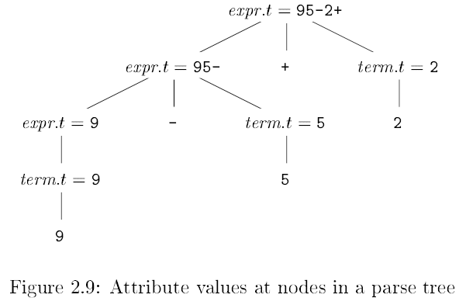

Slide 61
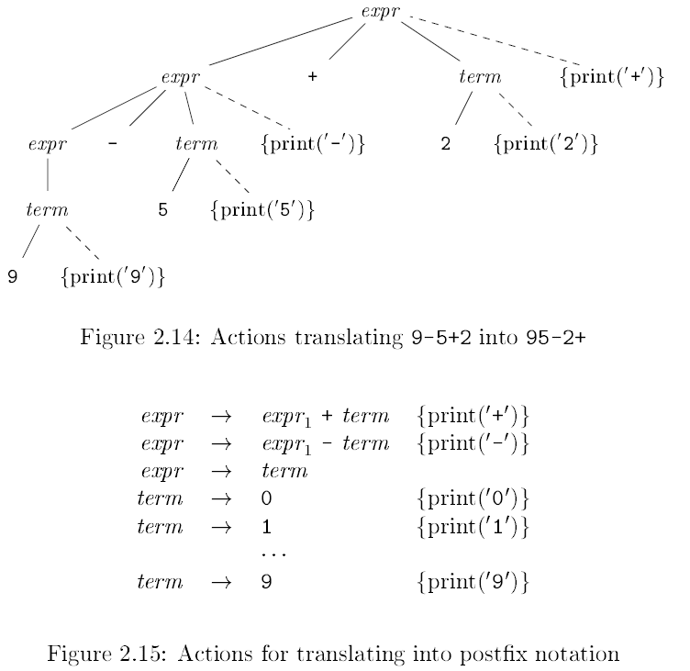

Slide 73
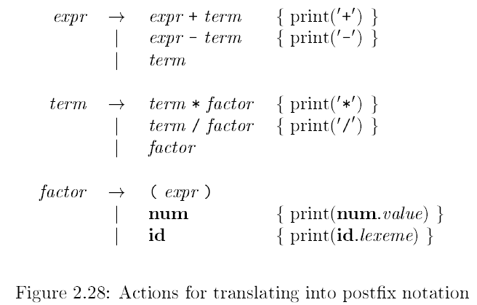

Slide 75
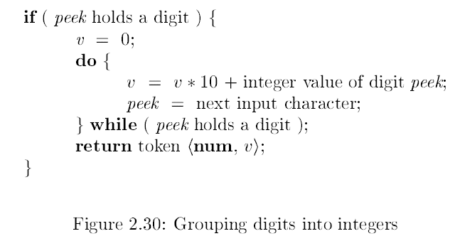

Slide 76
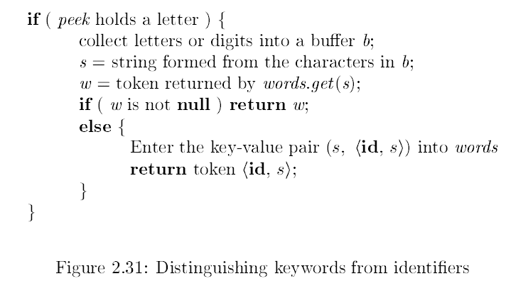

Slide 77
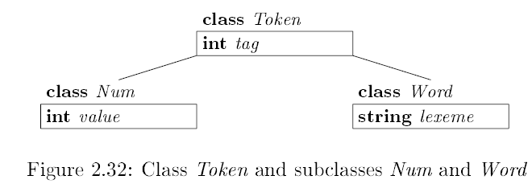

Slide 82
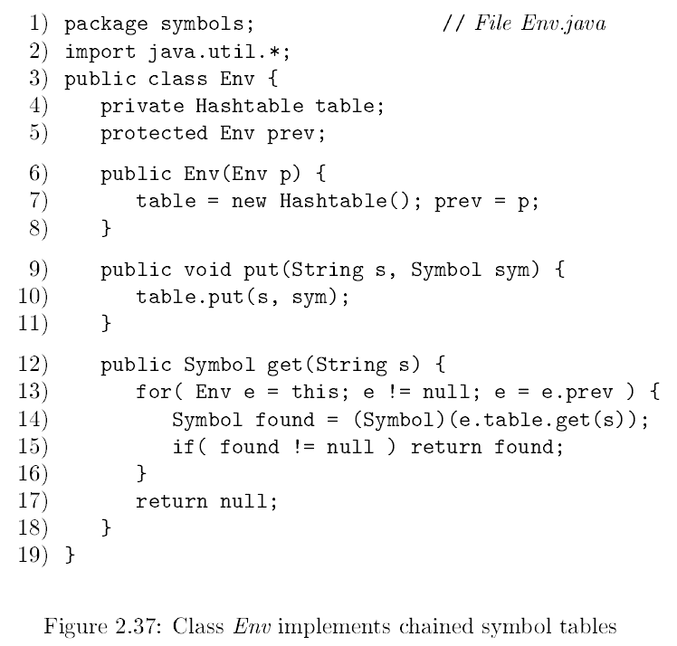

Slide 85
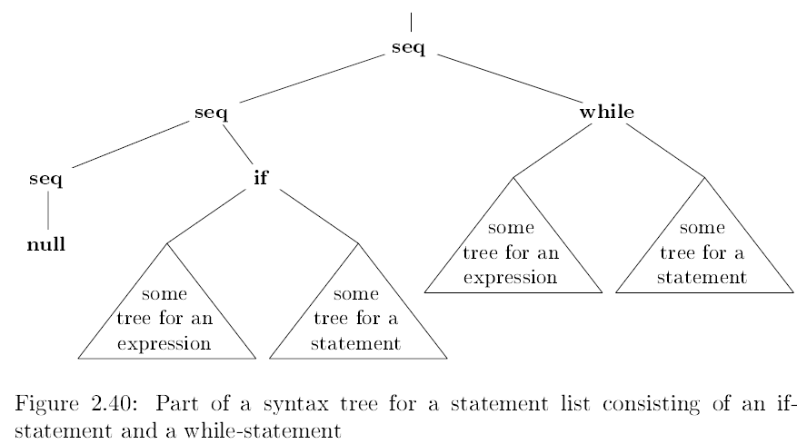

Slide 86
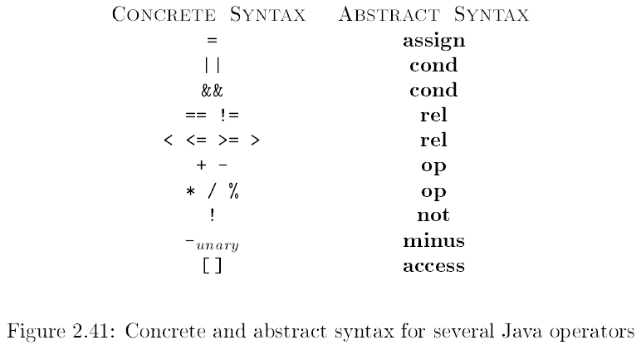

Slide 87
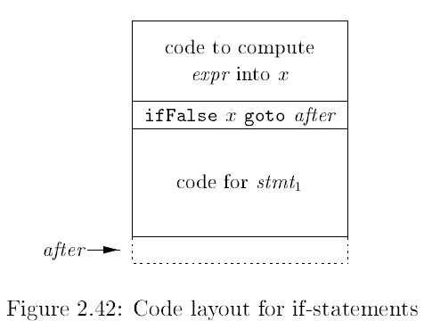

Slide 89
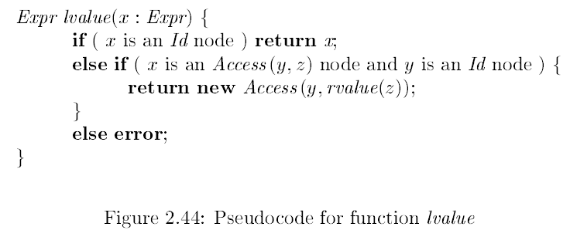

Slide 92
The End of Chapter 2

